Slide 1
About the Course
The long 20th century will in all likelihood be seen in the future as the watershed in human experience:
Nine aspects:
History was primarily economic—and that was true for the first time…
Explosion of wealth: 2%+ per year…
Cornucopia of technology…
Demographic transition…
Feminist revolution…
Empowered tyrannies…
Wealth gulfs…
Inclusion and hierarchy attenuation…
Mismanagement and insecurity…
Humanity is unlikely to see as transformative—for good and ill, but mostly for good, so far at least, I think—a century again…

Slide 2
Coronavirus!
Calls are Carol Christ’s…
She has made the call: classes are now moved online: I am busy adding audio to slide files
That said:
If you are coughing and sneezing, stay home! Email me and we will give you extra-credit points…
Otherwise, there are powerful herd-animal benefits to coming to lecture
(& to talking about course material with your friends: you need to convince your brain that these concepts are useful, & it should keep them)
Washington State has been doing an intensive flu screening, so they know stuff:
They guess: 1 in 1000 people in WA has coronavirus right now
Half of them have no symptoms
Asymptomatic transmission means that we cannot contain this without shutting society down
Cases doubling every 5 days
Means that by the end of March 1 in 45 people in WA will have it…
April will be epidemic month
In the end, 30%-70% of us will test positive
&, worldwide, 20 million people are likely to be dead
Our hope is to stretch out this process as long as possible, so that health providers are not totally overwhelmed

Slide 3

MOAR Coronavirus!
It’s a Thing for Geezers!
Mortality for the Youngs very low…
It’s the flu for them…

Slide 4
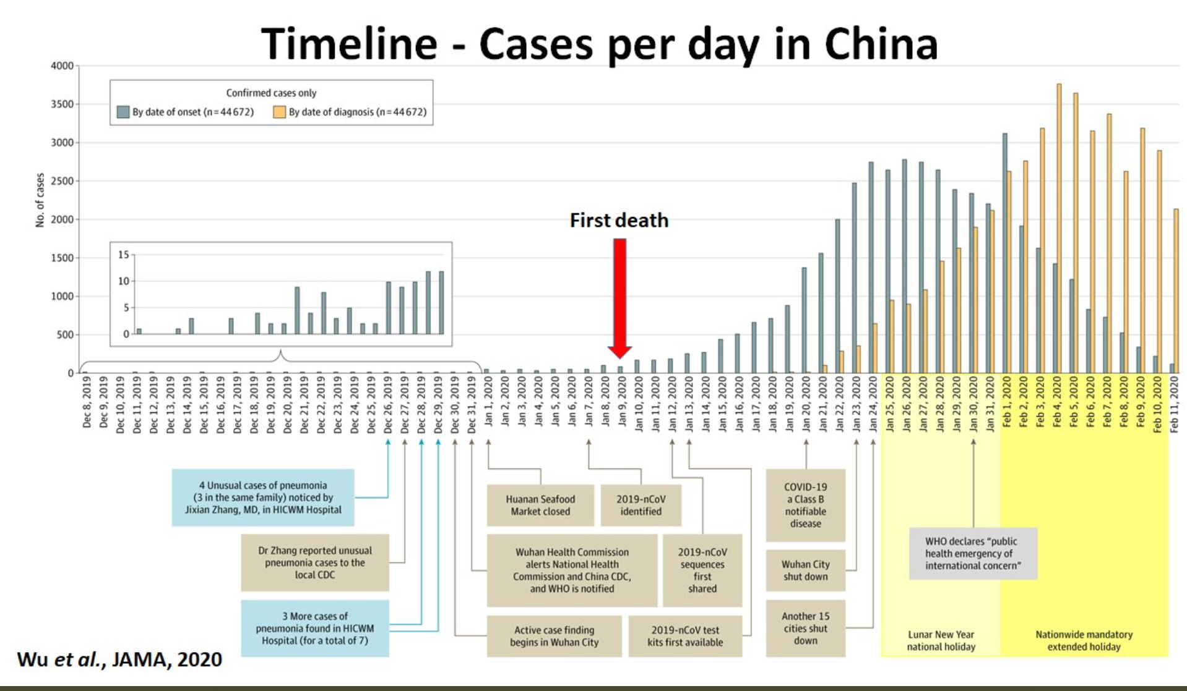
MOAR Coronavirus! II
China Beat It!
Shut down Wuhan when 200 cases per day
That seems to have been a good decision

Slide 5

MOAR Coronavirus! III
When Is It Appropriate to Move on This?
Immediate social distancing…
Self-isolate if you have a cough and a fever…
Hope that warmer temperatures will do to this what they did to SARS…
Otherwise, when do you want to start spreading out transmission. It seems that early is as good as later…

Slide 6
U.C. Berkeley: Economics 115: Spring 2020
20th Century Economic History: Lecture 11: False (and True) Starts to Convergence in Emerging Markets
Brad DeLong
Department of Economics and Blum Center, U.C. Berkeley; and WCEG
delong@econ.berkeley.edu
last revised: 2020-03-09
for delivery: W 2020-03-11 17:00 HMMB390
<https://bcourses.berkeley.edu/courses/1487684>
<https://github.com/braddelong/public-files/blob/master/econ-115-lecture-11.pptx>

Slide 7
Takeaways from Last Time
From Cold War
Come up with your own five takeaways from our look at the so-called “Cold War” from 1947 to 1989…

Slide 8
Preview
False (and True) Starts to Emerging Market Convergence
Takeaways from Last Time
Preview
Administration
The Cold War: There Was Not Supposed to Be One
The Korean War
Review: Broad sweep
Consequences: After the Korean War
Russia Sits Down
Takeaways
Preview

Slide 9
Econ 115: Administration: Office Hours &c.
DeLong: Office Hours
M 11:10-12:40, Blum Hall 200B
T 11:15-12:00, Blum Hall 200B
Email <delong@econ.berkeley.edu> for a virtual appointment
Read: DeLong, chapters 16 & 17
Slides: <https://github.com/braddelong/public-files/blob/master/econ-115-lecture-11.pptx>
Do: Assignments on suspension as we figure out what to do with the midterm…
Memo: bCourses website <https://bcourses.berkeley.edu/courses/1487684>

Slide 10
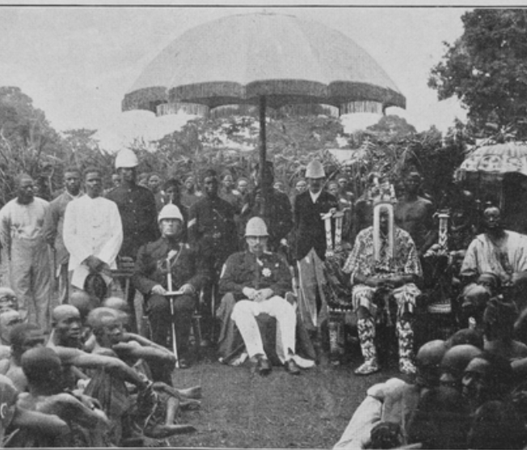

The Colonized Experience
The standard package for successful development;
Market-promoting government;
Building railroads, canals and ports;
Chartering banks for commerce and investment;
Establishing mass education
Imposing smart tariffs on those manufactured imports that would in the short-run crowd out production and thus the creation of the communities of engineering practice
Colonial masters would not allow the standard package
Neverthless, progress:
Even outside of the global north the world was far richer in 1950 than it had been in 1800
The center-of-gravity of what now is the global south was at a living standard of $2 a day in 1800s
$2.25 by 1870
$3.50 by 1913.
But still about $3.50 by 1950.
However, there were a number of economies that seemed to be taking advantage of opportunities:
Japan
Those parts of Latin America that escaped internal colonization by landed and bureaucratic elites
But the gap between global north and global south had grown: from 2.5 to 1 in 1800 to 4 to 1 in 1870 and 1913, and to 7 to 1 by 1950.
3:15
Notes:
Stable market-promoting government; building railroads, canals and ports; chartering banks for commerce and investment; establishing mass education; and imposing tariffs on those manufactured imports that would in the short-run crowd out production and thus the creation of the communities of engineering practice in those modern industries in which long-run comparative advantage lay—those were what Robert Allen and others have judged to have been the essentials for stepping on to the escalator of prosperity that was post-1970 modern economic growth.
But for the colonized in Asia and Africa before World War II that was not a possibility: they could not do that. Their colonial masters had little interest in and provided no support for such policies. And the competition that their natural resource products and their workers faced from the products and workers or extremely low-wage India and China crippled the wealth of a middle class that might otherwise have provided demand to spur industry, and made globalization more the foe than the friend of economic development.
How about Latin America, which had achieved independence from Spain and Portugal early in the 1800s? How did they do before World War II? Mexico, Columbia, Peru, Brazil, and the others suffered, by and large, from what one might call internal colonialists: a landed elite privileged by property ownership and Iberian descent that feared an educated proletariat, loved foreign-made manufactures, and had Iberian-derived legal systems that did not mesh well with the needs of commerce and industry.
Do not get me wrong: outside of the global north the world was far richer in 1950 than it had been in 1800, and richer by a substantial margin. If the center-of-gravity of what now is the global south was at a living standard of $2 a day in 1800s and $2.25 by 1870, it was about $3.50 by 1913. But, dragged down by China in war and revolution and by an India that had been heavily hit by the disruptions of trade that came with the Great Depression and then war, it was still about $3.50 by 1950. But there were a number of economies that seemed to be taking advantage of opportunities: Japan had already joined the industrial powers. Those parts of Latin America that escaped internal colonization by landed and bureaucratic elites were looked to be catching up: Chile, Argentina, Uruguay, and southern Brazil still looked more like a cross between an Australia and an Italy than like the externally or internally colonized. Venezuela had its oil boom. Cuba and Costa Rica showed signs of escape. Iran, Iraq, Lebanon, Egypt, Morocco, and Algeria; South Africa, Kenya, Zambia, Ghana, and Nigeria; Mexico and Peru all formed a global middle stratum.
But the gap between global north and global south had grown: from 2.5 to 1 in 1800 to 4 to 1 in 1870 and 1913, and to 7 to 1 by 1950.

Slide 11
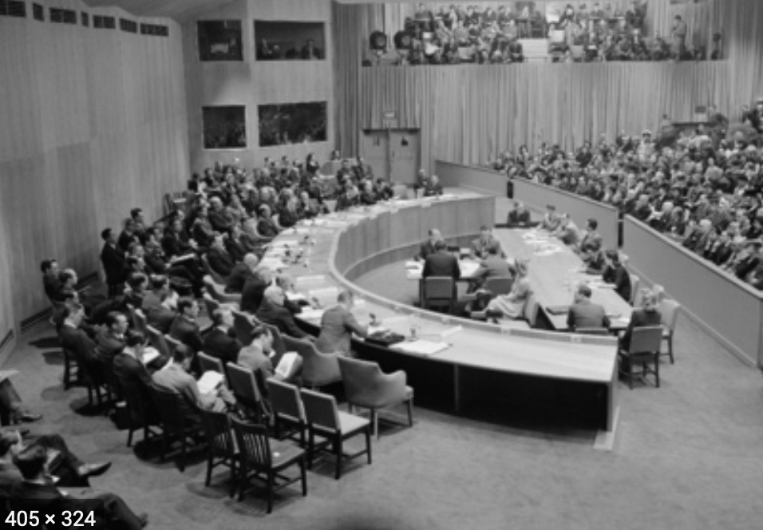
Political Hopes
After World War II the now-dominant United States would not bless colonialism
Social democratic governments rejected the civilizing mission of the colonial empires
And so colonial masters withdrew
The “winds of change” brought independence to Asia and Africa
And with these winds came great hopes for development—and democracy
2:00
Notes:
After World War II the now-dominant United States would not bless, the needs of reconstruction discouraged financing for, and more enlightened left and center-left governments rejected the civilizing mission of the colonial empires. And so Britain, France, and the others withdrew bit by bit. The “winds of change” brought independence to Asia and Africa. And the fall of kings elsewhere sapped the morale of landed elites of Iberian descent in Latin America.
The decolonized in Asia and Africa, and to a lesser extent those now less firmly leashed in Latin America, began with bureaucracies and structures of government typical of the industrial north: representative parliamentary institutions, independent judiciaries, laws establishing freedom of speech and of assembly, and formally apolitical civil service tradition among the bureaucracy. The hope had been that they would then see normal liberal democratic politics: semi-regular alternation in office of parties somewhat to the left and parties somewhat to the right of some sober centrist center of gravity of median voter preferences. The hope had been that, freed from the oppressive controlling hand of colonial rule our landed aristocracy, democracy in the newly-independent former colonies was thought likely to flourish.
And the hope had been that, since their economies would no longer be controlled in the interests of imperial authority or local landed aristocracy, economic prosperity would follow as well. They could now build the railroads, canals and ports; charter the banks for commerce and investment; establish mass education; and impose judicious tariffs to nurture the creation of the communities of engineering practice in those modern industries in which their long-run comparative advantage lay
But it was not to be.

Slide 12
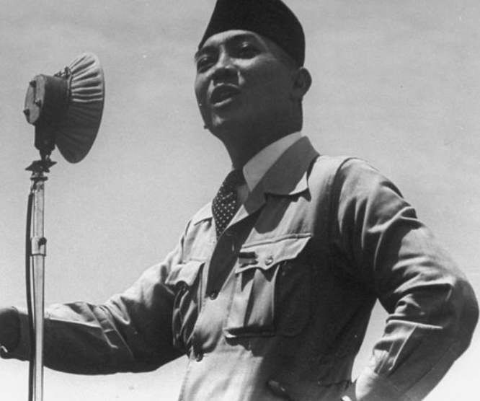
Political Realities
Westminster-style parliamentary politics and independent judiciaries soon became rare exceptions
Found only in India (a very important exception indeed) and a few others
Regimes emerged that derived their authority from”
The army and the police suppressing dissent
From populist attachment to a charismatic nation-symbolizing reforming leader
From a cohesive ethnic group that hung together lest they hang separately
1:40
Notes:
In much of the global south, the political aftermath of decolonization turned out to be a long-run disappointment. Westminster-style parliamentary politics and independent judiciaries soon became rare exceptions: found only in India (a very important exception indeed) and a few others. Instead, regimes emerged that derived their authority not from electoral competition between different groups of possible representatives but from the army and the police suppressing dissent with a varying level of brutality, or—in the best case—from populist attachment to a charismatic nation-symbolizing reforming leader. It would take generations after decolonization for the democratic tide to shift from ebb to flood.
The speed with which political democracy collapsed throughout much of the newly-decolonized third world was disheartening. It suggested that the institutions and practices that keep representative political democracy functioning throughout so much of the industrial core were much more fragile, vulnerable, and contingent than triumphalists would wish. But there was no historical reason to suppose that representative democracy and liberal freedom were the wave of the future. The country of Goethe and Schiller could not maintain them by itself, after all. And the democratizing phase of the great French Revolution had lasted for only four years. Why should anyone expect elsewhere to be different? Rather, be impressed by India, which with great tenacity maintained its hold on parliamentary democracy.

Slide 13
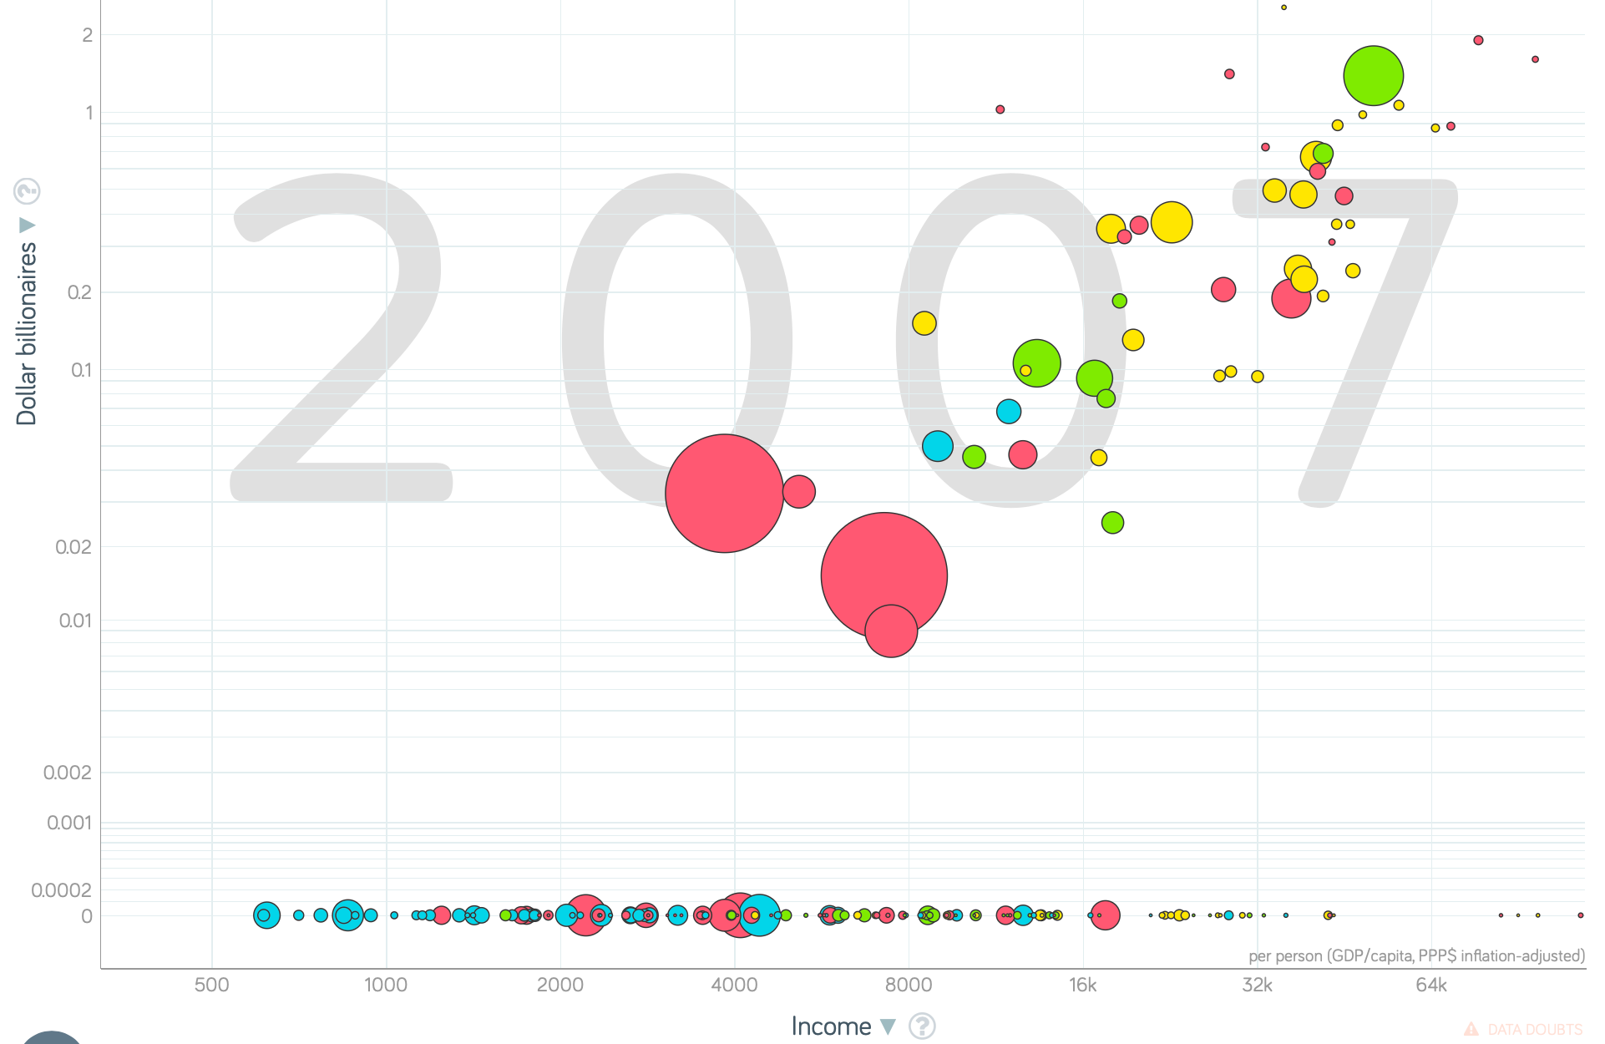
Economic Growth Realities
From a center-of-gravity of $3.50 a day as a living standard in 1950 to $6 or so a day in 1975,
The global south did grow
But it did not catch up
That widening stopped after 1975.
Since 1975, convergence for people
But since 1975, stasis for nation-states
Africa has fallen way, way behind
Perhaps most discouraging was the relative fall in the generation after independence of export crops
What went wrong?
The storehouse of industrial technologies developed since the industrial revolution is open
Many emerging markets that had seemed well on the escalator to modernity in 1950 or 1975 have failed of their promise.
A broadly richer world, yes.
A world much more integrated, yes.
But not convergence on the nation-state level
4:30
Notes:
From a center-of-gravity of $3.50 a day as a living standard in 1950 to $6 or so a day in 1975, the global south did grow in the thirty glorious years of the post-World War II social-democratic boom in the global north. But it did not catch up: the gap vis-a-vis the global north grew to 10 to 1. It was true that Iran, Iraq, Turkey, Syria, Lebanon; Mexico and Brazil; and South Africa appeared on the edge of the global north. Less-oppressive modern dictatorships produced rapid and impressive economic growth in the non-Communist fringe of Paciﬁc Asia, and in Saharan Africa. But elsewhere there was a widening of the relative income gap vis-à-vis the global north.
That widening stopped after 1975. From a global south income-level center-of-gravity of $6 a day in 1975 to $10 a day in 1990 to $15 a day (for the global south excluding China), and with China now at more than $30 a day, there has not for more than a generation been a continuing trend of widening global inequality.
However, Latin America lost a decade of development in the 1980s. Most of those for whom there were great hopes have disappointed: in Latin America today, only Chile and Panama are better-off then China; in Africa, only Botswana; in Asia, only Japan, the Four Tigers—Korea, Taiwan, Hong Kong, and Singapore—Malaysia, and Thailand; and in Latin America, only Chile (with Mexico, Costa Rica, and Brazil equal to) still exceeds China. And the gap between China and the global north is still a factor of 3.5 to 1 or so.
And Africa has fallen way, way behind: South Africa, Kenya, Zambia, Ghana, and Nigeria—all those for which there were great hopes for economic development into the 1960s have failed of their promise. And of the thirty poorest economies in the world today, only four—North Korea, Timor-Leste, Afghanistan, and Haiti—are outside Africa. Benin, Mali, Zimbabwe, Rwanda, Chad, South Sudan, Uganda, Ethiopia, Burkina Faso, the Gambia, Guinea-Bissau, Sierra Leone, Togo, Madagascar, Guinea, Eritrea, Mozambique, Malawi, Niger, Liberia, the DRC, Burundi, the CAR, and Somalia are the places where half or more of the population live lives not that distinguishable from those of our pre-industrial ancestors.
Perhaps most discouraging in Africa was the relatively rapid fall in the generation after independence of the production and exports of crops that had been the staples of African exports. As Robert Bates wrote as early as the start of the 1980s: “Palm oil in Nigeria, groundnuts in Senegal, cotton in Uganda, and cocoa in Ghana were one among the most prosperous industries in Africa. But in recent years, farmers of these crops have produced less, exported less, and earned less…” The only continent in which farmers still perhaps made up a plurality of the workforce was spending an ever-increasing portion of its export earnings on imported food. What went wrong? The storehouse of industrial technologies developed since the industrial revolution is open to all. The forms of knowledge and technologies that make the industrial west today so rich are public goods. The beneﬁts from tapping this storehouse are enormous, and have the potential to multiply the wealth of all social groups and classes—property owners and non-property owners, politically powerful and politically powerless alike—manyfold. All developing economies ought to have experienced not just substantial growth in absolute living standards and productivity levels, but ought to have closed some of the relative gap vis-a-vis the world’s industrial leaders since independence. Yet most emerging markets that had seemed well on the escalator to modernity in 1950 or 1975 have failed of their promise. A broadly richer world than in 1950, yes. A world much more integrated in terms of trade, technology, and the networks that are our value chains, yes. But not a more equal world—even if, since 1975, the trend toward increasing global economy has ended.

Slide 14
Review: Broad Sweep
What was the growth rate of ideas in the industrial core of the world economy over 1870-2020?
About 2.3%/year
About 0.9%/year
About 0.23%/year
About 4%/year
None of the above

Slide 15
Review: Broad Sweep
What was the growth rate of ideas in the industrial core of the world economy over 1770-1870?
About 2.1%/year
About 0.45%/year
About 0.15%/year
About 0.04%/year
None of the above

Slide 16


Kleptocracy
One short and too-simple answer is that the fault—where there is fault—lies in governments: kleptocracy
In a historical perspective kleptocracy—rule by the thieves—is nothing new
It is, rather, the rule
Most governments at most times in most places have followed policies that show little interest in nurturing sustained increases in productivity.
Why should we expect modern emerging markets to be different?
We would expect that governments would take great care to prevent food riots in the capital (and they do)
We would expect that governments would follow the advice of the Roman Emperor Septimius Severus and keep the army well-fed, well-paid, and equipped with lots of new weapons to play with (and they do).
Where government is stable and secure enough that it does not require draining resources from the rest of society to maintain its politicians in office and provide order for its supporters, then economic growth can take place
It can even be encouraged and accelerated by a developmental state…
2:26
Notes:
One short and too-simple answer is that the fault—where there is fault—lies in governments: kleptocracy—govenment by the thieves, as it has been named in analogy with aristocracy (goverment by the best), monarchy (goverment by the one), and democracy (government by the people)—has impoverished much of the third world over the past generation.
Yet in a historical perspective kleptocracy—rule by the thieves—is nothing new. Perhaps the major drawback to the invention of agriculture was that you had to be around to harvest the fields that you had planted. This meant that you could not run away when thugs-with-spears came by to demand the lion’s share of your crops. And as this became generally known, people got into the business of supplying spears for the thugs: we call such people “kings.”
Looking back at human history, it is easy to conclude that most governments at most times in most places have followed policies that show little interest in nurturing sustained increases in productivity. Why should we expect the modern Third World to be any different? We would expect that governments would take great care to prevent food riots in the capital (and they do), and would follow the advice of the Roman Emperor Septimius Severus and keep the army well-fed, well-paid, and equipped with lots of new weapons to play with (and they do). But the lifespan of the average government is too short to expect it to take a serious interest in the project of long-run economic development.
Where government is stable and secure enough that it does not require draining resources from the rest of society to maintain its politicians in office and provide order for its supporters, then economic growth can take place—and can even be encouraged and accelerated by a developmental state, both because most rulers would be benevolent if they thought they could, and because increasing prosperity can be a powerful source of increased stability and security.
This is the short answer.

Slide 17

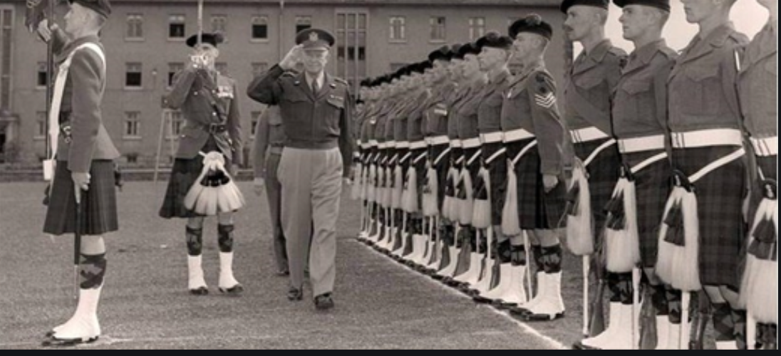
State-Building
Clashes between the logic of economic development on the one hand and the logic of political effectiveness on the other are much stronger when a government and a political order are new or shaky
Too many intellectuals on all sides applauded the strength of the state
The usually-reliable John Hall:
“Forced development is socially brutal. Such development cannot be achieved under the ægis of soft political rule, and this means that the chances of a transition to democracy are correspondingly at a discount. Modernization, under whatever politicial ægis, involves at least disciplining the peasantry and at most forcibly removing it from the land. the removel of tribalism, the destruction of rival cultures, the creation of a lingua franca, and the establishment of national bureaucracies. Third World countries have learnt with time that successful modernization is impeded by democracy. For people do not easily accept the loss of their land and of their customary ways of life: this requires force [and] a totalizing ideology…”
But development need not be “forced”
4:30
Notes:
17.2.2: State-Building
These possible clashes between the logic of economic development on the one hand and the logic of political effectiveness on the other are much stronger when a government and a political order are new or shaky than when they are old and established.
Throughout the post-World War II period intellectuals on all sides applauded the strength of the state, on the ground that only a strong state could perform the historical tasks necessary for economic development. As one usually clear-eyed observer, the political scientist John Hall, put it:
>forced development is socially brutal. Such development cannot be achieved under the ægis of soft political rule, and this means that the chances of a transition to democracy are correspondingly at a discount. Modernization, under whatever politicial ægis, involves at least disciplining the peasantry and at most forcibly removing it from the land. The removel of tribalism, the destruction of rival cultures, the creation of a lingua franca, and the establishment of national bureaucracies. Third World countries have learnt with time that successful modernization is impeded by democracy. For people do not easily accept the loss of their land and of their customary ways of life: this requires force [and] a totalizing ideology…
Now if you look at the successful economic developers of either the nineteenth or the twentieth centuries, you can see that this thinking is fuzzy. Successful development does not require “disciplining the peasantry” or “forcibly removing it from the land.” Successful development requires luring the peasantry off the land to higher-wage higher-productivity factory and commercial jobs in the growing cities. The prevalence of the belief that modernization “under whatever political aegis” is socially brutal rejects as a model for development the experience of the United States, France, Italy, Belgium, Japan, Taiwan, South Korea, and others and accepts as a model for development the Soviet Union of the 1930s: Stalin.
But it is fuzzy thinking that has made a—disastrous—difference.
For one thing, building and strengthening a state is a task that requires both the government’s attention and the government’s resources. Governments and states that wish to be strong need to reward their friends so that they will remain its friends, and to attract more friends. Governments and states that wish to be strong need to make it imprudent to become their enemies. Accomplishing this requires moving resources around: taking from some and granting to others. And if the some that the government takes from are those whose entrepreneurial abilities would have powered the next generation of economic growth? And if those whose entrepreneurship might have been devoted to boosting growth turn instead to figuring out how to profit from becoming friends of the state? Then growth suffers.
What is wanted to support successful economic development is a government strong but limited: strong in the sense that its judgments of property rights are obeyed, that its functionaries obey instructions from the center, and that the infrastructure it pays for is built; limited in the sense that it can do relatively little to help or hurt individual enterprises, and that political power is not the only effective road to wealth and status. And, in addition, it needs to be strong enough to steamroll over local and other notables whenever their interest is strongly opposed to that of economic growth.
This is a narrow tightrope to walk. Walking it may not be possible. Walking it is not possible when attempts at “statebuilding”, as they often have since World War II, aimed at a state that is strong and not limited—and have sometimes wound up with a state that is weak but unlimited: political power is the only effective road to wealth, but functionaries ignore instructions and extort bribes for administrative favors and the infrastructure that it pays for is not built.

Slide 18
Iran Under the Pahlavis—and After
Could things have been much better?
Dilemmas of Iranian development?
The “White Revolution”
Ayatollah Khomeini
A subsequent religious-ideological government
Not interested in economic development
Interested in paradise, not utopia
Oil money has kept Iran and its regime afloat
But convergence and development? Nah.
6:15
Notes:
Iran Under the Pahlavi Shah: A Case
Could things have been much better in the post-World War II periphery in the first generation? The case of the Iranian Revolution suggests that in some cases at least the answer is “no.” For the reasons that the Shah of Iran was overthrown, and Iranian industrialization brought to a near halt, in 1979 had relatively little to do with the faults of the then-Shah (which were many), but had much to do with obstacles to successful economic development. The pre-1979 Imperial Iranian government was a tyranny. It had a ﬁerce and dreaded secret police. It used revenues from sales of government-owned oil to build up an impressive and powerful military. But these were not the reasons that the Shah was overthrown. The Shah hoped to use the bulk of oil revenues to turn Iran into an industrial country in one generation. This meant, ﬁrst, land reform: distribute land to turn tenants and sharecroppers into independent farmers, and compensate landlords with government oil revenues. But rapid population growth and a desire not to offend rich landlords too much meant that the plots distributed were small. The boom in oil exports and the rise in oil prices together pushed up Iran’s exchange rate by a wide margin: and with an overvalued exchange rate, it became proﬁtable to import food. So newly-propertied peasant farmers found themselves with small plots and facing declining prices for what they sold.
They were supposed to become bulwarks of the regime, grateful to it for distributing land. Instead, they scratched what they saw as an inadequate living off of too-small plots, or moved to the cities. While a large share of the Iranian population saw their incomes growing rapidly in the years leading up to 1979, a large share of the Iranian population did not.
Moreover, as the world became smaller with transportation and communications, the people of Iran could see further into what was happening in other countries. For one thing, Russians and Britons and Americans were showing up—rich and arrogant. Iranians had been used to seeing themselves at the center of an Islamic civilization that had been preeminent among world civilizations for more than a millennium. Indeed, less than three centuries separate the joint Anglo-American-Russian occupation of Iran during World War II (in order to provide a logistical aid channel to the Soviet Union) from the days when the Islamic princes of Turkey and the Ganges Valley were besieging Vienna and overrunning the British East India company’s bases in Bengal.
How were people to make sense of such a world? Steps to emancipate women proved unpopular among traditional inﬂuence makers as well. Steps to boost education-and the Shah was truly and genuinely committed to turning Iran into a literate, educated, technologically-proﬁcient country-also produced a large body of students and intellectuals attracted to revolutionary politics. The Shah’s answer was to turn Iranians into Europeans—to follow an authoritarian state-led development road reminiscent of Japan, and earlier Germany. But this left no place for Islam. And it was highly corrupt. From exile, the Ayatollah Khomeini—a former opponent of land reform, who had thought it was un-Islamic to dispossess landlords and free peasants from debt bondage—lit the fuse, calling on the Islamic clergy and the people to seize power from the despot and make an Islamic revolution. A forty-day cycle of demonstrations began, during which young religious activists would be shot by the police, thus triggering another demonstration forty days hence to mourn their deaths. In January 1979 the Shah ﬂed into exile. Thereafter Iran’s economy stagnated. Iran today looks to be no richer than it was in 1977. First a decade-long war with Iraq absorbed tremendous resources. Then the newly-dominant religious government had little interest in economic development: they were interested in paradise in heaven, not in utopia here on earth: the Iranian people had not made the Islamic Revolution to lower the price of watermelons.
----
17.3: Ideological Damage
17.3.1: Damage from Ideologies of the Right
The ideologies of the right did enormous damage to prospects for successful economic development in the first half of the twentieth century. Colonialism itself almost inevitably came with an ideology that the natives were unfit: unfit to rule themselves, unfit to handle complicated machinery, unfit (with a few exceptions) for sophisticated education, unfit to do much of anything other than work on plantations and staff s

Slide 19

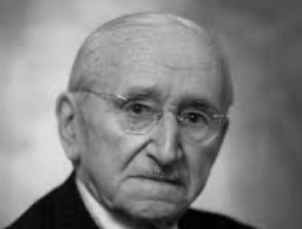
Ideological Damage
Ideologies were poisonous
On the right
Colonialism
Austerity
Reactions to failed bets on globalization
On the left
Marx’s fear of markets
But centrally planning will inevitably be very inefficient
And very corrupt
Threading the needle is hard
How has China managed?
6:30
Notes:
The ideologies of the right did enormous damage to prospects for successful economic development in the first half of the twentieth century. Colonialism itself almost inevitably came with an ideology that the natives were unfit: unfit to rule themselves, unfit to handle complicated machinery, unfit (with a few exceptions) for sophisticated education, unfit to do much of anything other than work on plantations and staff small shops.
The ideologies of the right did further damage to the extent that they caused, deepened, and prolonged the Great Depression. The idea that the only good economy was a gold standard economy helped start the Depression. The idea that a recession had a positive, long-run, social-darwinian effect on the economy helped deepen and prolong the Great Depression. And the fact that integration into the global economy caused large-scale economic disaster during the 1930s taught many governments in the 1940s and 1950s that they should avoid integration into the global economy: strategies of neo-autarky and import-substitution development that were fashionable in the 1950s, and that were by and large unsuccessful, had their roots in an overlearning of the lessons of the Great Depression.
17.3.2: Damage from Ideologies of the Left
If ideologies of the right did massive damage to prospects for economic development before 1950, ideologies of the left did massive damage to prospects for development since 1950. Newly-independent decolonized governments in the 1950s and 1960s listened to intellectuals from the left because the left had been anti-colonial—while the center and the right were, before World War II, imperialist. Thus the Indian National Congress would look to the British Labour Party—their friends in Britain—for advice on how to create the preconditions for successful economic growth. And left wing political opinions throughout most of the twentieth century have been at least somewhat friendly toward really-existing socialism. And that friendliness carried with it Marx’s doctrine that markets are evil in their essence— hence anything that replaced markets must be good. This had a very large influence on third world development policy in the first post-WWII generation. The tying of left wing commitments ﬁrst to the really-existing socialist Leninist-Stalinist régime established in Russia after the Bolshevik Revolution, and then to the successor régimes that emerged from decolonization did harm to the political left as a moral entity. Marx had looked forward to immense material wealth evenly distributed, to freedom of occupational and residential choice, to representative governments, to free speech and free association. But the really-existing socialist governments that the political left found itself associated with—the products of the Bolshevik revolution and of decolonization—had relatively little of these. The commitment to representative government was the ﬁrst commitment the political left threw overboard: only an educated and informed electorate could exercise its right to vote, and until such an educated and informed socialist electorate could be created, a centralized party was necessary in its place. To rank representative institutions high on any list of the criteria of a good society was, it was mistakenly thought, implicitly to attack decolonization and to defend the late colonial order. The commitment to free speech and free association went next. Nation-building required unity. If politicians and newspapers could whistle different tunes and criticize the government, this would disrupt the fragile unity of new nations. Then advocacy of private economic freedoms disappeared: all of the resources of society had to be mobilized according to a single plan for rapid industrialization.
Thus the left-wing historian E.P. Thompson could write in the 1970s that:
...the Communists of the 1930s and 1940s were not altogether wrong, intellectually or politically. [The] visions [we feared] were of Panzers or of Sherman tanks rolling into the East, breathing racial purity or the freedom of capital down the barrels of their guns...
Put to one side the rhetorical pairing (at the end of the 1960s!) of Franklin Roosevelt and Adolf Hitler: either E.P. Thompson is an idiot, or it is an exaggeration not meant to be taken seriously. Note instead that, in Thompson’s mind, freedom of speech, freedom from arbitrary execution, freedom to elect the government, and material wealth orders of magnitude greater than that produced by Stalin’s bureaucracy—all these piled together—count for little because they come tied to “freedom of capital.” Eggs were broken. The habit of breaking them on whim grew. But no omelet appeared.

Slide 20
Neoliberal Turns and Developmental States
Perhaps the miracle is that there was so much growth…
Chile, Mexico, southern Brazil, and Panama in Latin America
Algeria in Saharan and Botswana in sub-Saharan Africa
Hong Kong, Malaysia, Singapore, South Korea, Taiwan, Thailand, and now, of course, China in Asia
Developmental states where they work
Elsewhere, a neoliberal turn
6:00
Notes:
From a cynical perspective the interesting question might be not why was there economic stagnation in much and absolute economic decline in some ofemerging markets, but why there was rapid growth in other portions. Chile, Mexico, southern Brazil, and Panama in Latin America; Algeria in Saharan and Botswana in sub-Saharan Africa; and Hong Kong, Malaysia, Singapore, South Korea, Taiwan, Thailand, and now, of course, China in Asia are countries that have made impressive strides toward closing the relative material prosperity gap vis-a-vis the global north in the post-World War II era. How have they managed to do this? What have been the key factors separating successful from unsuccessful episodes of economic development?
The natural conclusion from emerging-market history is that successful economic development is difficult without either a limited government or a developmental state: the logic of politics is that of favors performed, wealth redistributed, inﬂuence exercised, and taxes collected; that is very different from the logic of economic growth. Only a state that is limited in the amount of damage it can do to the economy, or a state that is secure enough, independent enough, and committed to rapid economic growth can avoid this development trap.
These are the two roads to successful rapid development: “neoliberalism,” on the one hand; and the so-called “developmental state” approach that has been so successful in East Asia on the other. Either insulate the economy from the (semi-predatory) government so that the government’s attempts to tilt the distribution of income in favor of the politically powerful are relatively ineffective and do little harm, or create a government bureaucracy whose first goal is development, and which views interests as its tools to be used in promoting economic growth, rather than as its masters.
These pressures have, in the post-World War II period at least, been strong enough to counteract the natural tendency for poor countries to learn rapidly about technology and catch up to rich ones. There is no clear reason on the horizon for these pressures to diminish. Optimists hope that the record of economic failure provided by much third world experience in the past generation will lead to the creation of intellectual pressures for reform strong enough to overcome the bias for stagnation. And if ideas truly are the decisive forces making history in the long run, perhaps the optimists are right.
If the optimists are wrong, then we are all in big trouble. Successful handling of the future’s global environmental problems, and successful long-run stabilization of human populations, hinges on successful industrialization in the third world and the consequent—rapid—passage through the demographic transition.
----
One way to read the economic history is as repeated attempts to produce the second: to create a pro-growth “developmental state.” Yet in the last analysis there is nothing worse than state-led development led by an anti-developmental state. And that was what too many post-independence Asian and African and too many post-World War II Latin American states turned out to be.
Thus starting in the 1980s hopes for development—outside of the Pacific Rim, where the successful “developmental state” has been was already clearly a reality— shifted in the direction of “neoliberalism.” It seemed better to try to limit the state’s involvement in the process of development, because its interventions were more likely to be destructive than constructive. Rely, instead, on the world market as a source of demand, and on the requirements for integration into the world market and cooperation with the international agencies set up after World War II as a source of good-enough governance.

Slide 21
Takeaways from This Time
False (and True) Starts to Emerging Market Convergence
Give me five takeaways from this lecture…

Slide 22
Notes: What Was Unconvincing Today?
Mistakes and unclarities: typos, wordos, and mindos…
In the DRAFT textbook?
In the lecture?

Slide 23
Catch Our Breath…
Ask a couple of questions?
Make a couple of comments?
Any more readings to recommend?

Slide 24
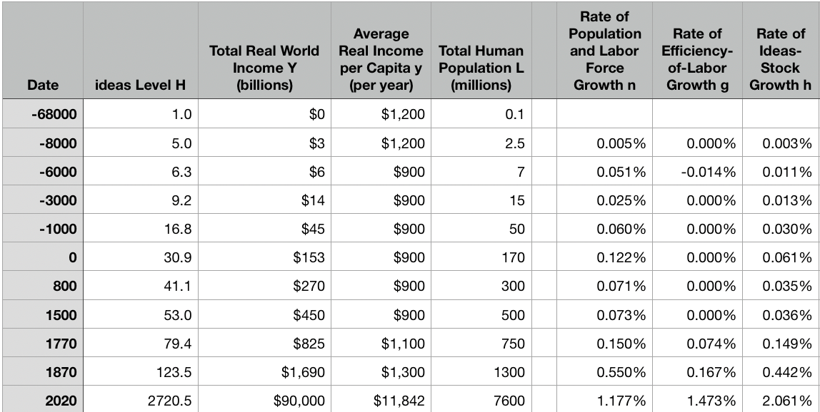
Reviews
Post-1870 is the miracle:

Slide 25
Review: The Broad Sweep
Post-1870 is the miracle:

Slide 26
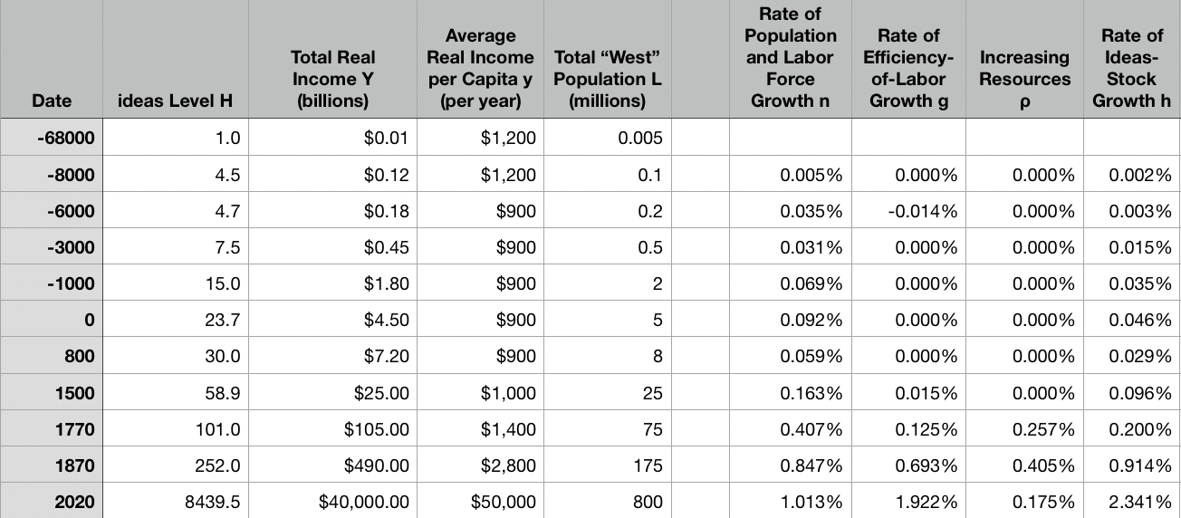
“The West”
800, 1500, 1770, or 1870?:

Slide 27
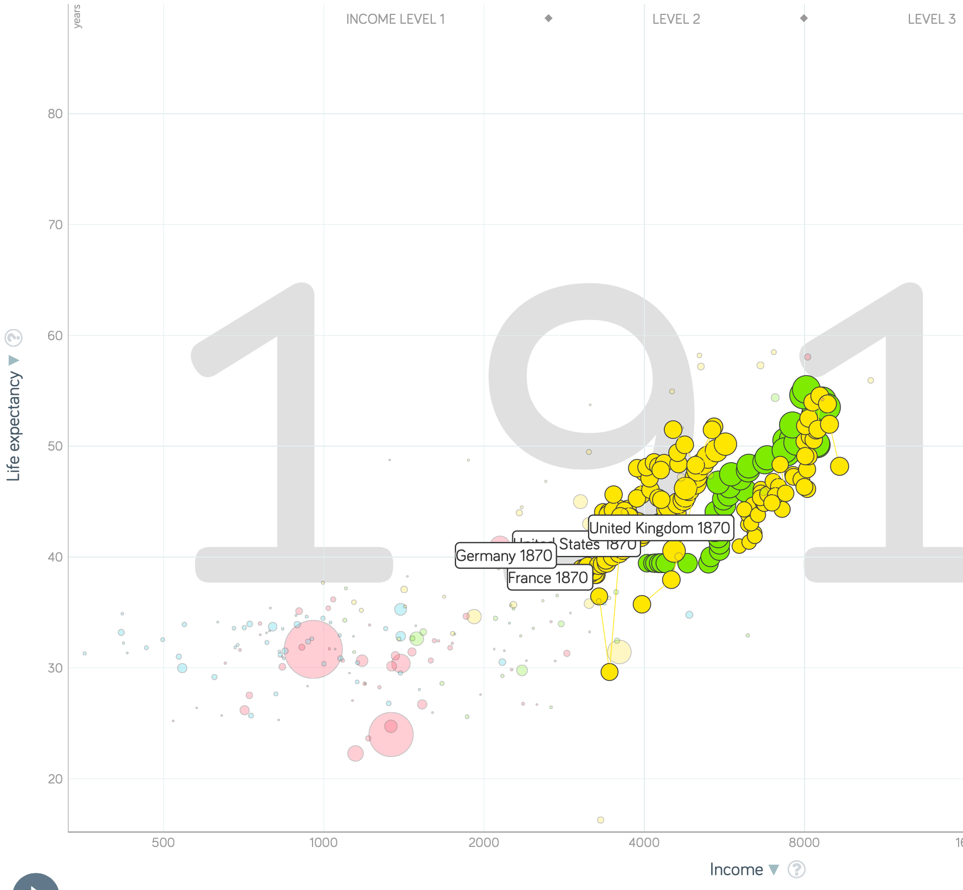
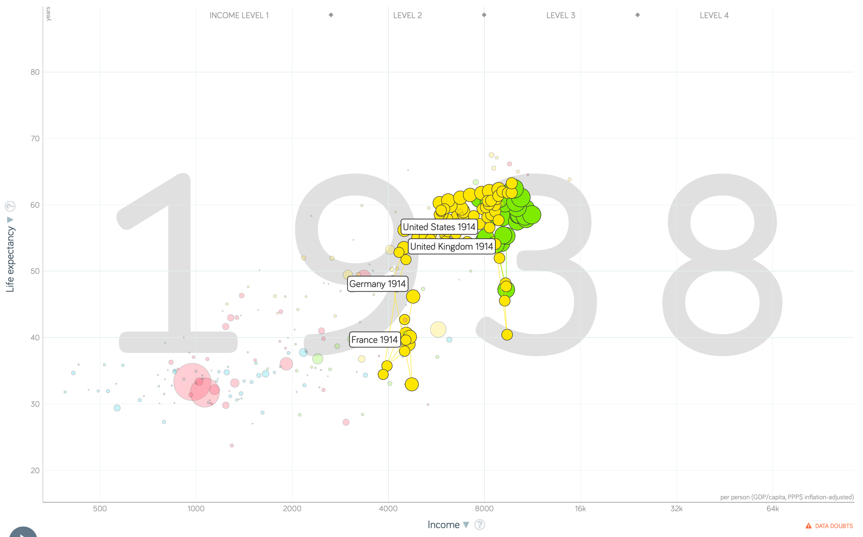
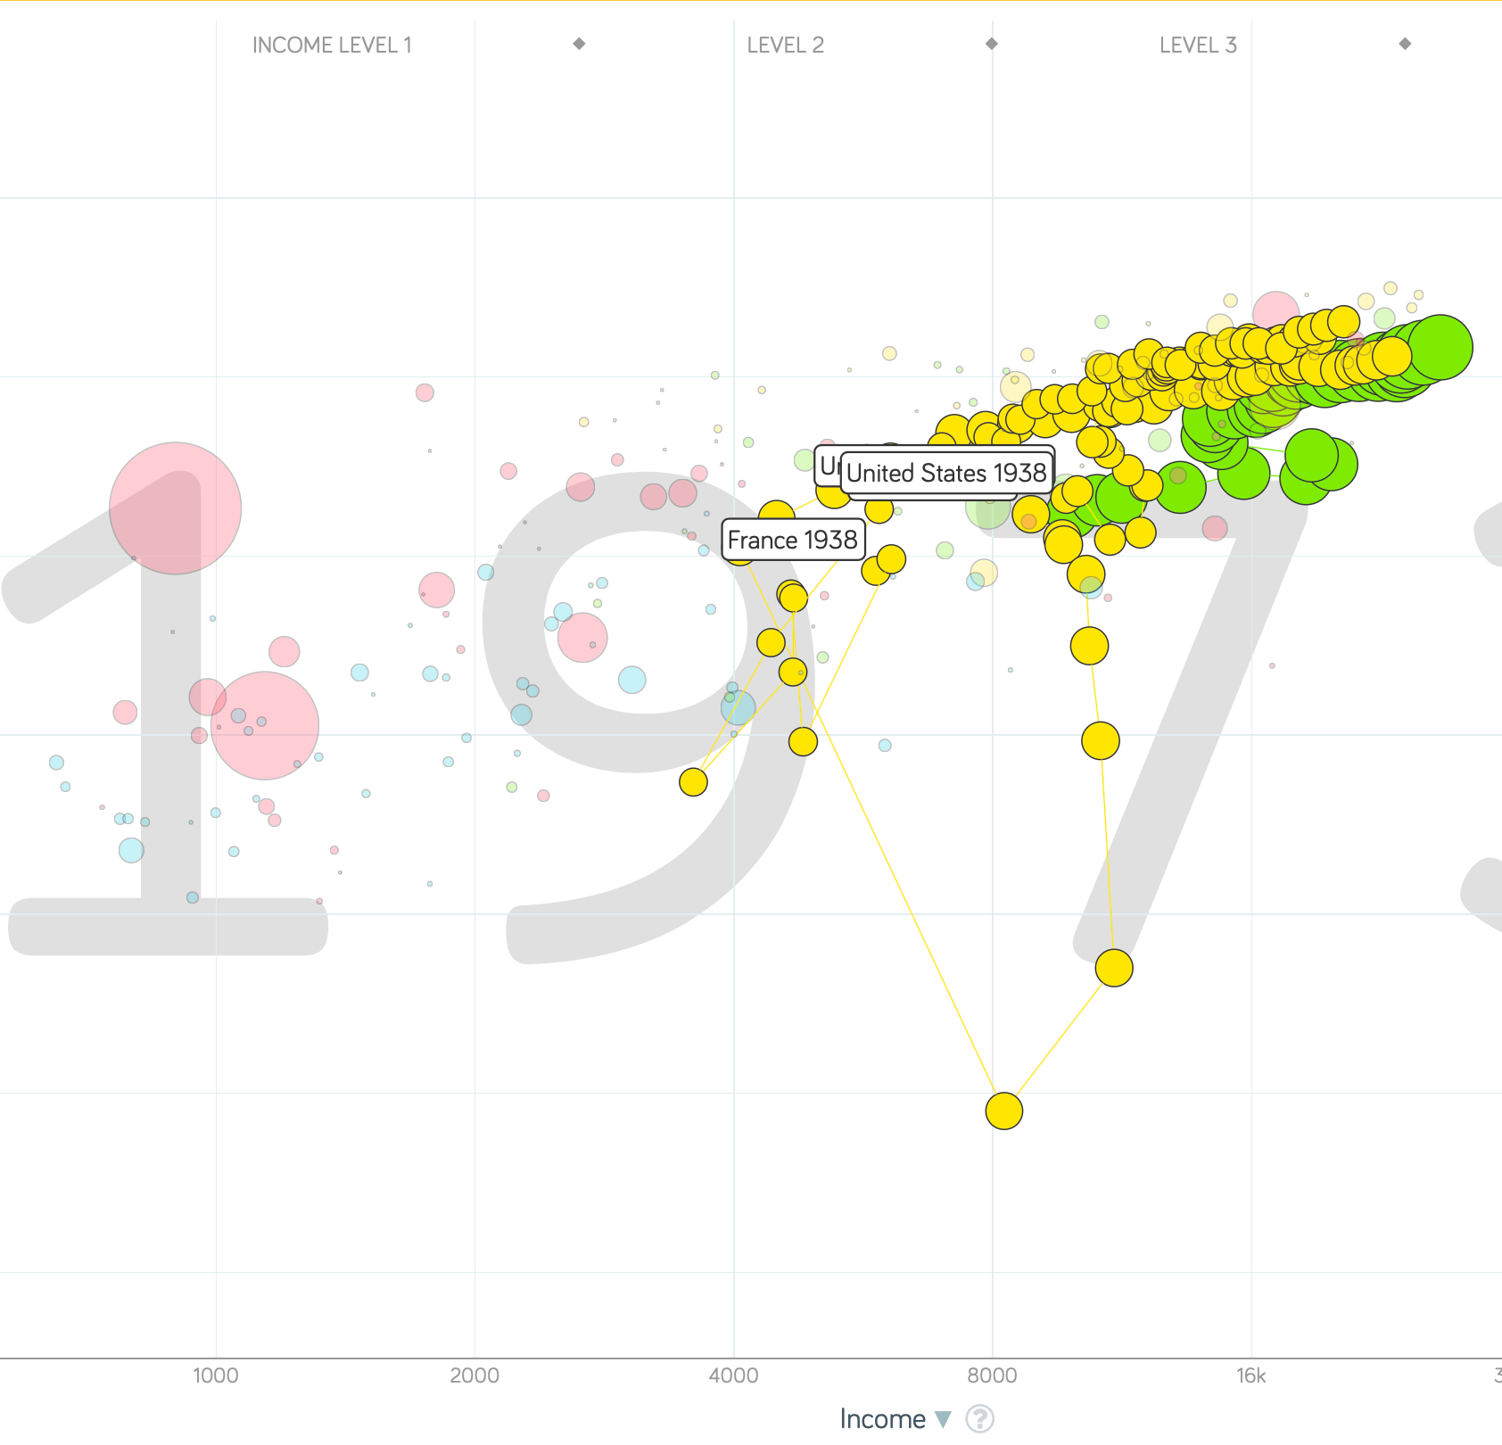
“The West”
1914-1938, 1870-1913, & 1938-1973
Rate of growth in the North Atlantic industrial core halves comparing 1870-1913 to 1914-1938; then triples afterwards over 1938-1973
Slows again after 1973

Slide 28
To Your iClickers
What was the growth rate of ideas in the industrial core of the world economy over 1870-2020?
About 2.3%/year
About 0.9%/year
About 0.23%/year
About 4%/year
None of the above

Slide 29
To Your iClickers
What was the growth rate of ideas in the industrial core of the world economy over 1770-1870?
About 2.3%/year
About 0.9%/year
About 0.23%/year
About 4%/year
None of the above

Slide 30
Review: The Belle Époque Broken
John Maynard Keynes:
“Very few of us realise[d] with conviction the intensely unusual, unstable, complicated, unreliable, temporary nature of the economic organisation by which Western Europe has lived for the last half century. We assume some of the most peculiar and temporary of our late advantages as natural, permanent, and to be depended on, and we lay our plans accordingly.
“On this sandy and false foundation we scheme for social improvement and dress our political platforms, pursue our animosities and particular ambitions, and feel ourselves with enough margin in hand to foster, not assuage, civil conflict in the European family....
“France, Germany, Italy, Austria, and Holland, Russia and Roumania and Poland, throb together, and their structure and civilisation are essentially one. They flourished together, they have rocked together in a war which we, in spite of our enormous contributions and sacrifices (like though in a less degree than America), economically stood outside, and they may fall together…”

Slide 31
Aristocracy & Social Democracy
The aristocrats had rolled the dice:
Europe in 1914 was a Europe of national populations, of industrialists and socialists, of factory workers and technicians…
Europe’s governments in 1914—especially the defense and foreign affairs ministries—had been populated by aristocrats, ex-aristocrats, and would-be aristocrats.
Landed, aristocratic, military elites had control of many of the levers of propaganda and power…
Aristocrats had had help. Industrialists and entrepreneurs were eager to provide their political support in return for economic benefits, as in the 1879 German “marriage of iron and rye”: the imposition of tariffs on imports of British steel (to protect the positions of German manufacturers) and on imports of American grain (to protect the positions of German landlords)…
On the eve of World War I, these landed military service aristocrats, ex-aristocrats, and would-be aristocrats increasingly found themselves members of a social caste that had no societal function…
But power—in the form of office and of vast (if declining relative) wealth—and propaganda—in the form of pageantry and the press—were reinforced by ideologies: Social darwinism…
The aristocrats rolled the dice—and lost…
Social democrats picked up the chips:
Expanded suffrage…
Proportional representation…
“Lands fit for heroes…”
How to provide for the benefits politicians promised?

Slide 32
Reparations, Taxes, and Inflation
Reparations
A peace “without annexations and indemnities”…
But not without reparations…
Two years’ of Germany’s national income demanded:
Much of it “boob bait for the bubbas…” on the part of Allied politicians…
But a powerful shaper of post-WWI Germany
Taxes
High and progressive tax rates…
A powerful impact on inequality…
Class war…
Inflation
U.S.: price level x1.5
Britain: price level x2.0
France: price level x7.0
French government had encouraged investment in Russian bonds…
German: price level x1,000,000,000,000
Austria, Hungary, Czechoslovakia the same…

Slide 33
Keynes’s Protest
Jan Christian Smuts:
“Poor Keynes often sits with me at night after a good dinner and we rail against the world and the coming flood. And I tell him that this is the time for Grigua’s prayer (the Lord to come himself and not to send his Son, as this is not a time for children). And then we laugh, and behind the laughter is [Herbert] Hoover’s horrible picture of thirty million people who must die unless there is some great intervention. But then again we think that things are never really as bad as that; and something will turn up, and the worst will never be. And somehow all these phases of feeling are true and right in some sense…”

Slide 34
Keynes’s Protest II
John Maynard Keynes:
“If we aim deliberately at the impoverishment of Central Europe, vengeance, I dare predict, will not limp. Nothing can then delay for long that final civil war between the forces of reaction and the despairing convulsions of revolution, before which the horrors of the late German war will fade into nothing, and which will destroy... the civilization and progress of our generation…”

Slide 35
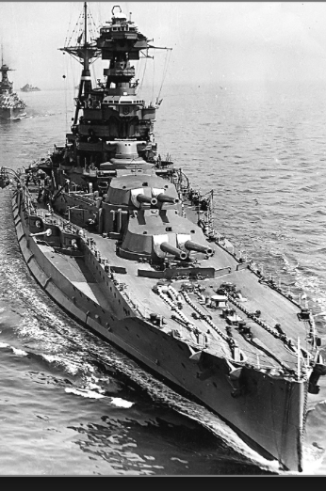
Review: World War I
Nationalism
Max Weber: “The vulgar conception of political economy is that it consists in working out recipes for making the world happy.… However… elbow-room… can [only] be won… through the hard struggle.... That standard of value adopted by a German economic theorist, can… be nothing other than a German policy and a German standard.... Our successors will... hold us responsible... for the amount of elbow-room we conquer.... The science of political economy is... a servant of... the lasting political-power interests of... our nation's power, and the vehicle of that power, the German national state…”
Erich von Manstein: von Manstein, von Lewinsky, Lewinski, Levi…
“We offered 4 battleships a year, the navy demanded 6, and we compromised at 8”

Slide 36
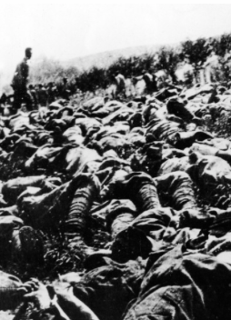
The Catastrophe of World War I: Origins
In the summer of 1914 the empires of Russia and Austria-Hungary are skirmishing diplomatically and threatening each other militarily about the latest Balkan crisis
Began when in the summer of 1914 the Archduke Franz Ferdinand and his wife Sophie were assassinated in Sarajevo
By terrorists with very close links to the intelligence service of the Kingdom of Serbia
What would Austria’s response be?
And then Germany attacks Belgium
And then Australia attacks Turkey

Slide 37
The Catastrophe of World War I: Causes
Why?: “If there is a war, let it come now…”
Russia thought it would have to fight Germany someday, and might as well while France was interested…
Austria, France, Britain (as a result of the German battle fleet) the same
“Busy giddy minds with foreign quarrels…”
A wiser man: Otto von Bismarck:
“There is nothing in the Balkans worth the bones of a single Pomeranian grenadier…”

Slide 38
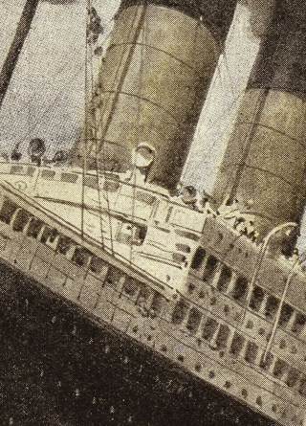
How Does the U.S. Get Involved?
British policy: binding the U.S. upper class to Britain since the 1840s
The Law of the Sea
Neutrals
Blockade
The submarine
Unrestricted submarine warfare
Zimmerman Telegram
Woodrow Wilson
“Teach the Mexicans to elect good men…”
“The war to end war…”

Slide 39
The Catastrophe of World War I: Outcome—Human
Combatants had mobilized 65M out of 100M men of military age
10M killed
10M maimed
Civilian casualties less than 10% of military
Costs of 1.5x a year’s GDP
Plus a 15M global flu epidemic
Russian, Austro-Hungarian, German, Ottoman Turkish Empires all gone…
Representative governments destabilized—or weak…
The Russian Revolution…
Hungarian, Bavarian socialist republics (short-lived)
Spartakist…
Allies demand 2 years of German GDP as “reparations”…

Slide 40
Catch Our Breath…
Comments?
Questions?

Slide 41

Review: Edward Bellamy: Looking Backward
Edward Bellamy: Looking Backward <https://delong.typepad.com/files/bellamy-backward.pdf>: Perhaps the third best-selling novel of the 19th century in the United States
2000 is a utopia…
The narrator is carried forward in time from 1887-2000 by an implausible plot device:
‘“This is the tenth day of September in the year 2000, and you have slept exactly one hundred and thirteen years, three months, and eleven days…”’
He then wanders around, looking at the utopia of 2000…
The opening:
‘“How could I live without service to the world?” you ask…. The answer is that my great-grandfather had accumulated a sum of money on which his descendants had ever since…. The sum had been originally by no means large. It was, in fact, much larger now that three generations had been supported upon it in idleness, than it was at first…’

Slide 42
The Stagecoach of Society
Those who ride and this who pull:
‘Commiseration was frequently expressed by those who rode for those who had to pull the coach, especially when the vehicle came to a bad place in the road, as it was constantly doing, or to a particularly steep hill. At such times, the desperate straining of the team, their agonized leaping and plunging under the pitiless lashing of hunger, the many who fainted at the rope and were trampled in the mire, made a very distressing spectacle, which often called forth highly creditable displays of feeling on the top of the coach.
‘At such times the passengers would call down encouragingly to the toilers of the rope, exhorting them to patience, and holding out hopes of possible compensation in another world for the hardness of their lot, while others contributed to buy salves and liniments for the crippled and injured. It was agreed that it was a great pity that the coach should be so hard to pull, and there was a sense of general relief when the specially bad piece of road was gotten over. This relief was not, indeed, wholly on account of the team, for there was always some danger at these bad places of a general overturn in which all would lose their seats.
‘It must in truth be admitted that the main effect of the spectacle of the misery of the toilers at the rope was to enhance the passengers’ sense of the value of their seats upon the coach, and to cause them to hold on to them more desperately than before…

Slide 43
The Stagecoach of Society II
“Finer clay”:
‘The other fact is yet more curious, consisting in a singular hallucination which those on the top of the coach generally shared, that they were not exactly like their brothers and sisters who pulled at the rope, but of finer clay, in some way belonging to a higher order of beings who might justly expect to be drawn. This seems unaccountable, but, as I once rode on this very coach and shared that very hallucination, I ought to be believed.
‘The strangest thing about the hallucination was that those who had but just climbed up from the ground, before they had outgrown the marks of the rope upon their hands, began to fall under its influence. As for those whose parents and grand-parents before them had been so fortunate as to keep their seats on the top, the conviction they cherished of the essential difference between their sort of humanity and the common article was absolute. The effect of such a delusion in moderating fellow feeling for the sufferings of the mass of men into a distant and philosophical compassion is obvious.
‘To it I refer as the only extenuation I can offer for the indifference which, at the period I write of, marked my own attitude toward the misery of my brothers…

Slide 44
The Stagecoach of Society III
Class war:
‘The sanguine argued very forcibly that it was in the very nature of things impossible that the new hopes of the workingmen could be satisfied, simply because the world had not the wherewithal to satisfy them. It was only because the masses worked very hard and lived on short commons that the race did not starve outright, and no considerable improvement in their condition was possible while the world, as a whole, remained so poor.
‘It was not the capitalists whom the laboring men were contending with, these maintained, but the iron-bound environment of humanity, and it was merely a question of the thickness of their skulls when they would discover the fact and make up their minds to endure what they could not cure.
The less sanguine admitted all this. Of course the workingmen’s aspirations were impossible of fulfillment for natural reasons, but there were grounds to fear that they would not discover this fact until they had made a sad mess of society. They had the votes and the power to do so if they pleased, and their leaders meant they should. Some of these desponding observers went so far as to predict an impending social cataclysm. Humanity, they argued, having climbed to the top round of the ladder of civilization, was about to take a header into chaos…’

Slide 45
The Limit of Human Felicity I
In the music room:
‘She made me sit down comfortably, and, crossing the room, so far as I could see, merely touched one or two screws, and at once the room was filled with the music of a grand organ anthem; filled, not flooded, for, by some means, the volume of melody had been per- fectly graduated to the size of the apartment. I listened, scarcely breathing, to the close. Such music, so perfectly rendered, I had never expected to hear.
‘“Grand!” I cried, as the last great wave of sound broke and ebbed away into silence. “Bach must be at the keys of that organ; but where is the organ?”…
‘“There are a number of music rooms in the city, perfectly adapted acoustically to the different sorts of music. These halls are connected by telephone with all the houses of the city…. Any one of the four pieces now going on that you prefer, you can hear by merely pressing the button which will connect your house-wire with the hall where it is being rendered…”’

Slide 46
The Limit of Human Felicity III
Four live orchestras you can listen to on the speakerphone!
‘“It appears to me, Miss Leete,” I said, “that if we could have devised an arrangement for providing everybody with music in their homes, perfect in quality, unlimited in quantity, suited to every mood, and beginning and ceasing at will, we should have considered the limit of human felicity already attained, and ceased to strive for further improvements…”’

Slide 47
Review: The View from 3000: Themes & Big Ideas
Science reaches critical mass and from it springs engineering—all of the engineering subdisciplines, including the management of human resources and of organizations. From a liberal political order spring national and then the global market economy. And from engineering and the market, and the large bureaucratic corporation then, over the course of 1870-2016, spring…
History was economic…
Explosion of wealth…
Cornucopia of technology…
Demographic transition…
Feminist revolution…
Inclusion and hierarchy attenuation…
Empowered tyrannies…
Wealth gulfs…
Mismanagement and insecurity…

Slide 48
Measuring Growth
What are my estimates of the rate of growth of economically-useful human knowledge over 1-1500, 1500-1800, 1800-1870, and 1870-2000?
0.02%/year, 0.2%/year, 0.5%/year, and 0.8%/year
0.000%/year, 0.02%/year, 0.2%/year, and 0.8%/year
0.02%/year, 0.2%/year, 0.8%/year, and 2.3%/year
0.2%/year, 0.8%/year, 2.3%/year, and 4.7%/year
None of the above.

Slide 49
What Is the Key Factor in the Explosion of Wealth in the 20th Century?
Yes, many things contributed. But suppose you have to pick just one

Slide 50
What Are the Four Factors That I See as Making for the Explosion of Wealth in the 20th Century?
Yes, there are many, many more things that contributed. But suppose you have to pick just four:

Slide 51
Demography II
What is the principal cause of the demographic transition?
Female wealth and control of property.
Female literacy.
Falling infant and child mortality.
Land shortages and high unemployment.
Something else.

Slide 52
Feminism
How many pregnancies do we think Abigail Smith Adams had between when she was 20 and 34?
2.
4.
6.
8.
18.

Slide 53
Empowered Tyrannies II
How many world leaders are members of the 10-million club?
2.
4.
6.
8.
18.

Slide 54
Inclusion and Hierarchy Attenuation
At the start of the 1970s, future President Ronald Reagan said that diplomats from Tanzania appeared uncomfortable:
resisting pressure to vote with the Soviet Union at the United Nations.
making small talk with New York socialites.
wearing shoes.
in formal tuxedos.
None of the above.

Slide 55
Economic Mismanagement and Insecurity II
According to Karl Polanyi, what rights does the market economy respect?
rights to land (a stable community).
rights to labor (a “just” income).
rights to finance (a stable economic place).
rights to property (the ability to keep what you manage to claim to earn).
None of the above.

Slide 56
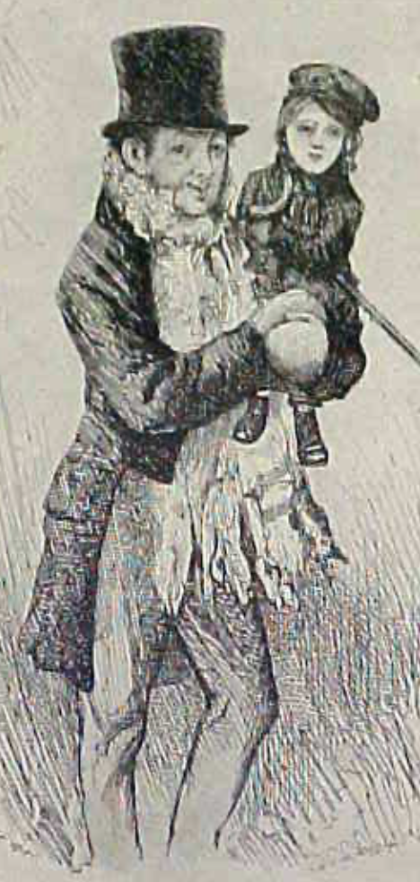
Review: The Watershed: 1870 as an Inflection Point
As of 1870, had the Industrial Revolution raised the standard of living or lightened the toil of the working class in England, the country at its center?
Yes
No
It’s not clear
Why? Malthusian forces—population explosion & thus smaller farm sizes. Growth, the growth had been slow 0.8%/year?

Slide 57
Globalization
Who called the era of globalization and growth from 1870 to 1914 an “economic El Dorado”?
Karl Marx
John Stuart Mill
Thomas Robert Malthus
John Maynard Keynes
None of the above
What would the others have said?

Slide 58
Migration
How many people of the roughly 1.5 billion then-population of the world left their continents of origin between 1870-1913?
10 million
50 million
100 million
200 million
400 million

Slide 59
Before 1870, Ideas Growth Not Fast Enough
And population growth accelerates as the world is not rich enough to undergo the demographic transition:
Value of useful and deployed ideas about technology and organization
-8000: 1
1: 3.5
1500: 4.75
1800: 9
1870: 16
2020: 421
Growth Rates:
-8000 to 1500: 0.02%/year
1500 to 1800: 0.2%/year
1800 to 1870: 0.8%/year
1870 to 2020: 2.3%/year
What caused these accelerations? What caused this last acceleration?

Slide 60
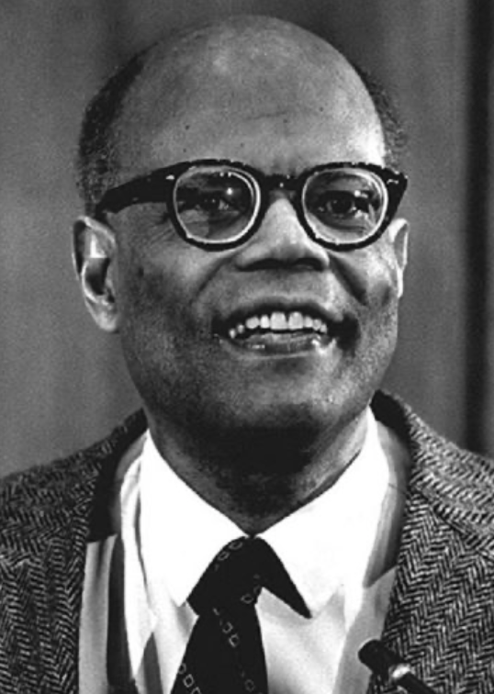
The Last Acceleration
The industrial research lab to routinize invention, and the modern corporation to routinize diffusion and deployment
Plus general purpose technologies—machine tools, non-human power sources
Arthur Lewis:
“New commodities: telephones, gramophones, typewriters, cameras, automobiles, and so on, a seemingly endless process whose latest twentieth-century additions include aeroplanes, radios, refrigerators, washing machines, television sets, and pleasure boats. Thus a rich man in 1870 did not possess anything that a rich man of 1770 had not possessed; he might have more or larger houses, more clothes, more pictures, more horses and carriages, or more furniture than say a school teacher possessed, but as likely as not his riches were displayed in the number of servants whom he employed rather than in his personal use of commodities…”
Not so much the particular technologies, as the grasping of the fact that there was a broad and deep range of new technologies to be discovered.
As much as it was new technologies, it was large-scale corporate organizations that could and did plan the division of labor to make use of and then market technologies.
And as much, it was that the global market meant that there was now a great deal of money to be made from the routinization of the exploration, development, and deployment of technological possibilities

Slide 61
Worldwide: The Broad Sweep
Post-1870 is the miracle:

Slide 62
“The West”
800, 1500, 1770, or 1870?:

Slide 63
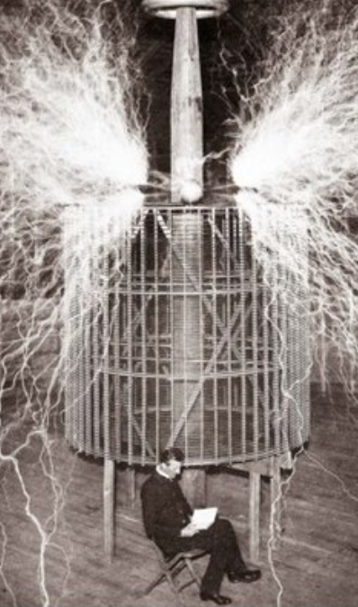
Who Is This Man?
And is he in any real danger?
Thomas Edison, and no
Andrew Carnegie, and no
Nicola Tesla, and no
Thomas Edison, and yes
Herbert Hoover, and yes

Slide 64
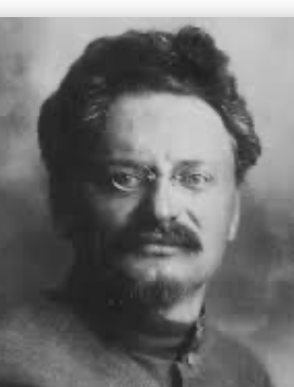
Lev Bronstein
Why did he say this?
“I had had no time to more than catch the general life-rhythm of the monster known as New York…”
“I left for Europe with the feeling of a man who has had only a peek into the furnace where the future is being forged…"

Slide 65

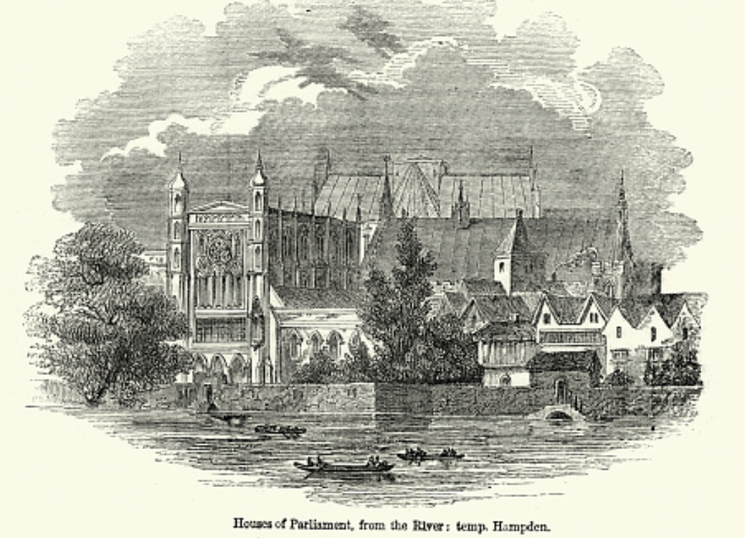
Review: Political Economy
From “Divine Right” and “Natural Order” to Enlightenment values…
Who was the first person to draft these words:?
“We hold these truths to be sacred & undeniable:
that all men are created equal & independant,
that from that equal creation they derive rights inherent & inalienable,
among which are the preservation of life, & liberty, & the pursuit of happiness;
that to secure these ends, governments are instituted among men, deriving their just powers from the consent of the governed…”
John Locke
Niccolo Machiavelli
Thomas Hobbes
Thomas Jefferson
George Washington
Why did he write them?

Slide 66
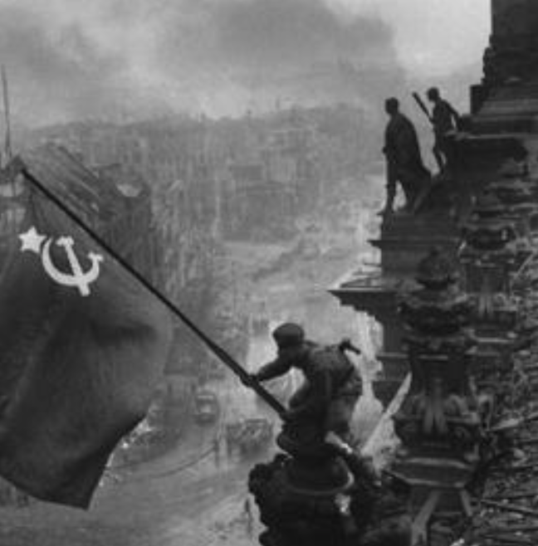
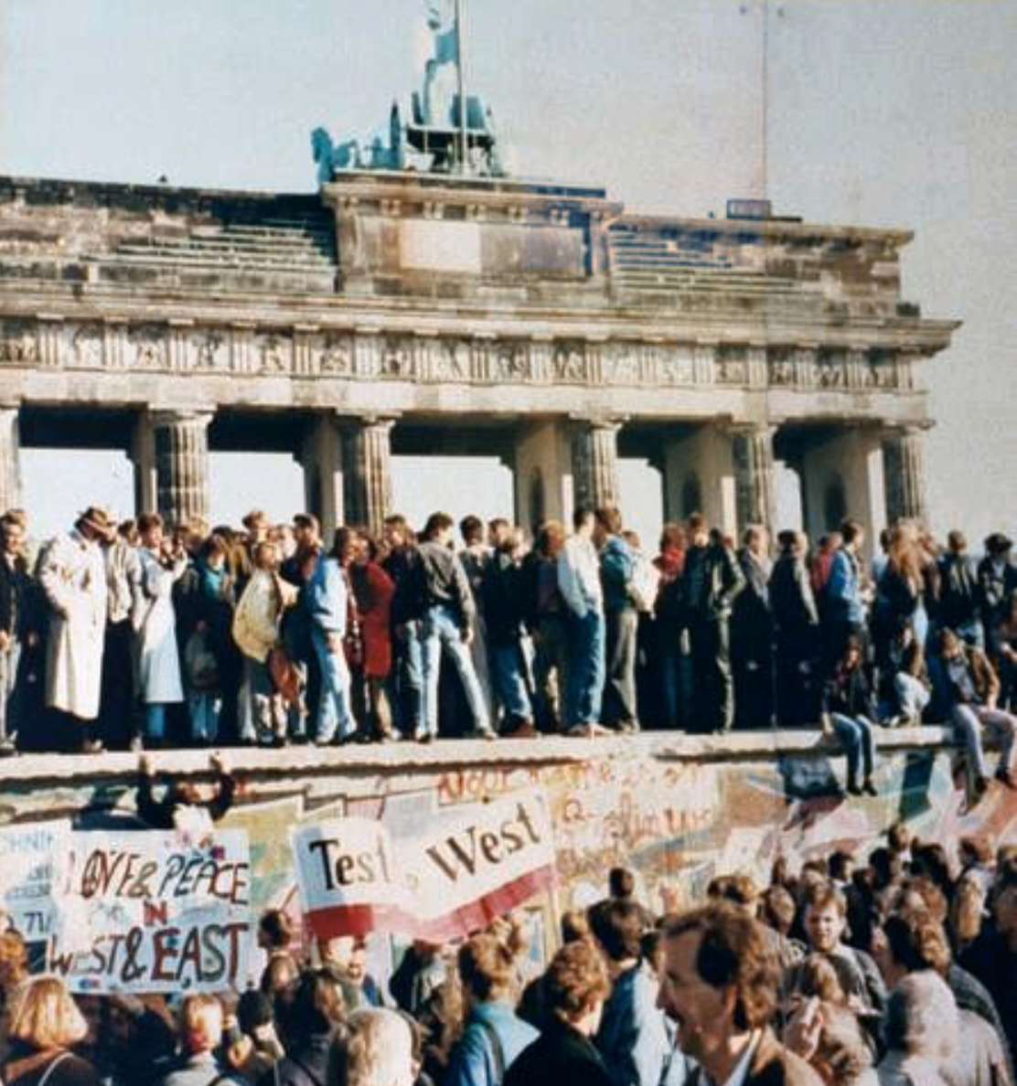
What Was the Proper Political Order?
Fears of “democracy” among American founders:
Madison: “Democracies have ever been spectacles of turbulence and contention... incompatible with personal security or the rights of property... as short in their lives as... violent in their deaths…”
Jefferson: “Gen’l Washington had not a firm confidence in the durability of our government… [& this] had some weight in his adoption of… ceremonies… calculated to prepare us gradually for a change which he believed possible…”
Hamilton: “the British government… best” as the only one “unit[ing] public strength with individual security…”
Adams: The American president should be announced as: “His Highness, the President of the United States, and Protector of the Rights of the Same…”
Question of political order thought settled: first in the rubble of Berlin in 1945, and then in the streets of East Germany in 1991:
Settled in favor of representative democracy, private property, & social insurance—late-1900s liberal democracy
But now reopened? Min Zhu (朱民) to me in 2015: “What are you Americans going to do to fix your broken political system?”

Slide 67
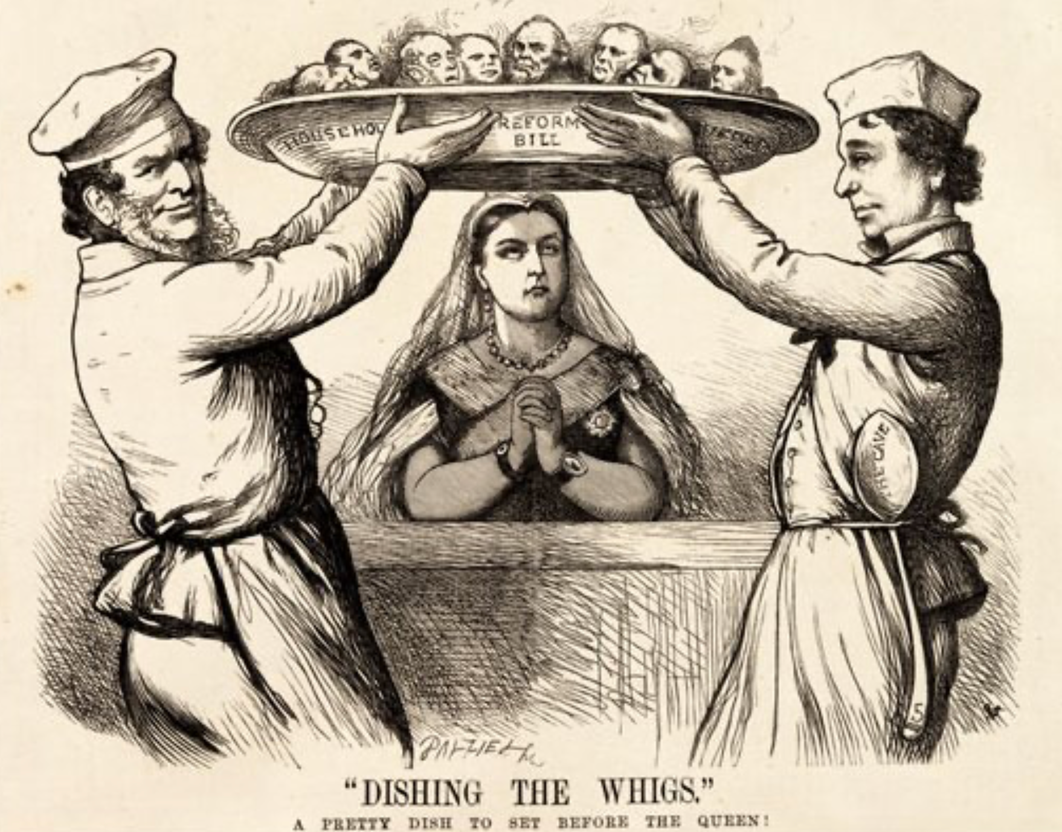
Franchise Restricted to the Rich Could Not Maintain Itself
The dynamic of franchise extension
Liberals in power would try extend on the principle that the new, poorer voters would be less conservative and would support them.
Threatening revolution would lead even conservatives to seek to extend the franchise in order to peel off of the revolutionary coalition those of the disenfranchised who had the most social power:
Earl Grey (yes, the tea): “The Principal… is to prevent… revolution…. I am reforming to preserve, not to overthrow…”
Charismatic leaders with popular followings would seek to give them votes, and then rule via plebiscites—going around the traditional elites
(Peculiar thing about Trump-Johnson: minority, and core is a minority of a minority…)
Conservatives: “dish the Whigs”—opportunities to form winning coalitions by appealing to those who were no profiting from the market economy, or felt that they were losing relative status in some ways…

Slide 68
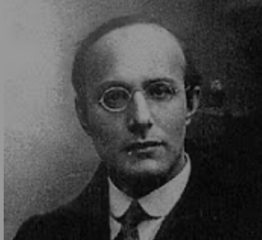
Popular Government and the Market Economy: Society’s Revenge
Karl Polanyi
People believe they have rights—to stable, supportive, nurturing communities; to incomes commensurate with their skills and status; and to money flows that will provide economic stability…
But a market society turns these things—land, labor, and finance—into commodities…
But they are not real commodities, they are fictitious commodities
And so you get your rights only if they satisfy a market profitability test
The only rights a market society respects are property rights:
& the only property rights that are worth anything are those that help you produce things for which rich people have a serious jones
Society will have its revenge: it will protect itself against the market logic, somehow, some way…

Slide 69
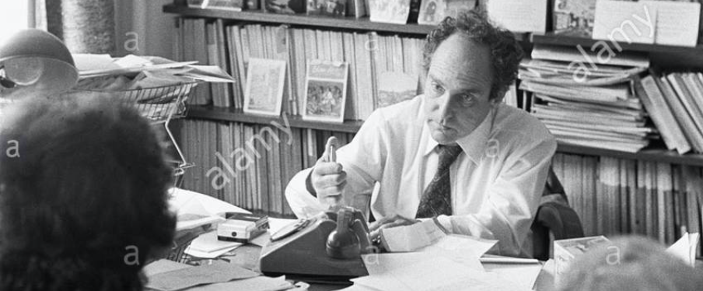


Digression: 5 Thinkers
Who shape my thought about the long 20th century—and how should, I think, shape yours
Beware! They are all deeply flawed…
But they are also geniuses, each in his way…
Beware of their followers! An iron law of ideology: a thinker’s most extravagant and aggressive followers will latch onto the stupidest and most shortsighted and wrong of their doctrines…
In historical order: Marx, Keynes, Hayek, Polanyi, Gellner
The other three thinkers:
Keynes: All that we need to produce general prosperity is technical adjustments to our system. Then the kingdom of freedom and prosperity will be within our grasp—and our major problems will no longer be economic ones
Gellner: The energy that most 19th century thinkers thought would go to “class“ went to “ethnos“ or “umma“ instead. The construction of ideological legitimations that makes sense both to dominants and to submissives who nevertheless believe they are part of some in-group is the key to understanding how societies stabilize themselves
Marx: Only the market economy will focus society’s energy on paying through the nose to boost the economy’s capital stock and to harvest the fruits of science and technology and then deploy them in production. But because the only demands in a market economy that matter are effective demands, the market economy also becomes a more “effective” means of slavery, for private property leads the proletariat to enslave themselves

Slide 70
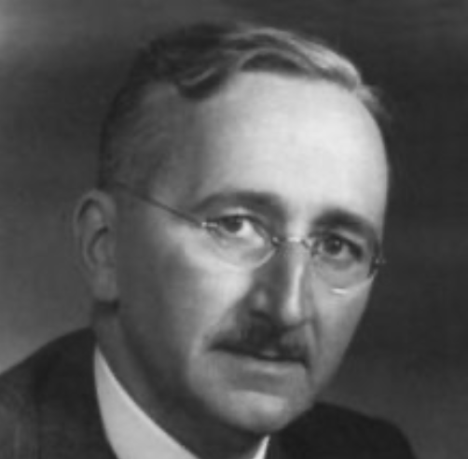
Hayek and Polanyi
Thumbnails on our first two:
Hayek:
Only the market economy can use society’s knowledge.
But the market economy cannot produce “social justice” and should not be asked to try—in fact, we need to recognize that all we can attain is freedom, and that will bring general prosperity, but that justice will be forever outside our reach
Polanyi:
The market economy turns land, labor, and finance into “fictitious commodities”
Society will have its revenge via a “double movement”

Slide 71
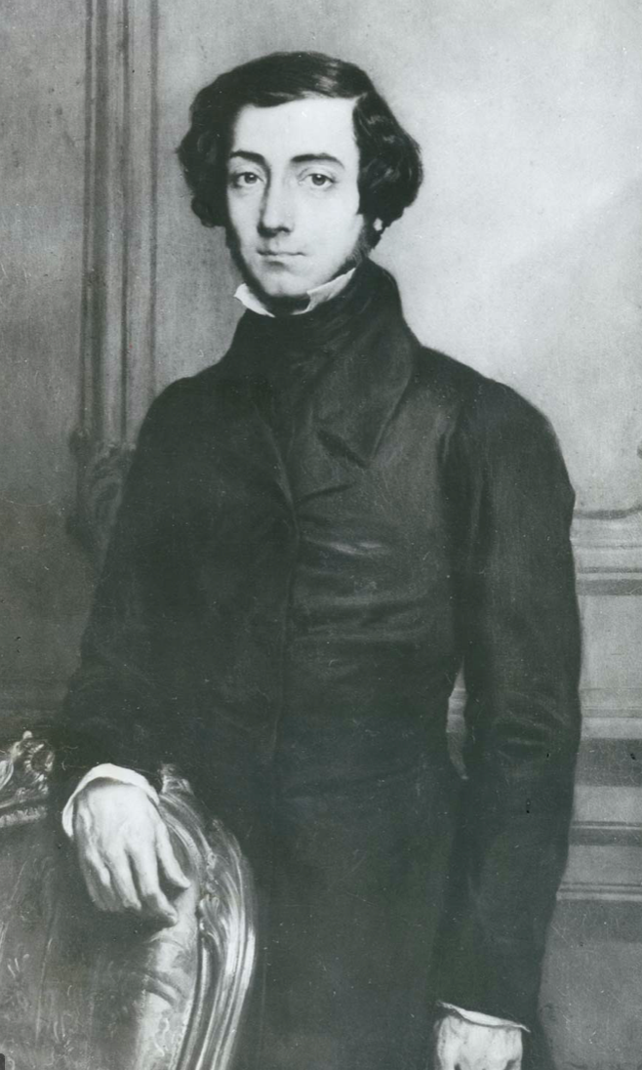
Plus Tocqueville
Toqueville on the rich as “elder brothers” in 1848:
“In the country all the landed proprietors, whatever their origin, antecedents, education or means, had come together, and seemed to form but one class: all former political hatred and rivalry of caste or fortune had disappeared from view. There was no more jealousy or pride displayed between the peasant and the squire, the nobleman and the commoner; instead, I found mutual confidence, reciprocal friendliness, and regard. Property had become, with all those who owned it, a sort of badge of fraternity. The wealthy were the elder, the less endowed the younger brothers; but all considered themselves members of one family, having the same interest in defending the common inheritance. As the French Revolution had infinitely increased the number of land-owners, the whole population seemed to belong to that vast family. I had never seen anything like it, nor had anyone in France within the memory of man…”
“The territorial aristocracy of past ages… [was] obliged… to come to the help of its servants and relieve their distress” no such reciprocal ties of obligation bound the aristocrats of manufactures to their workers: thus “the manufacturing aristocracy which we see rising before our eyes is one of the hardest that have appeared on the earth…”

Slide 72
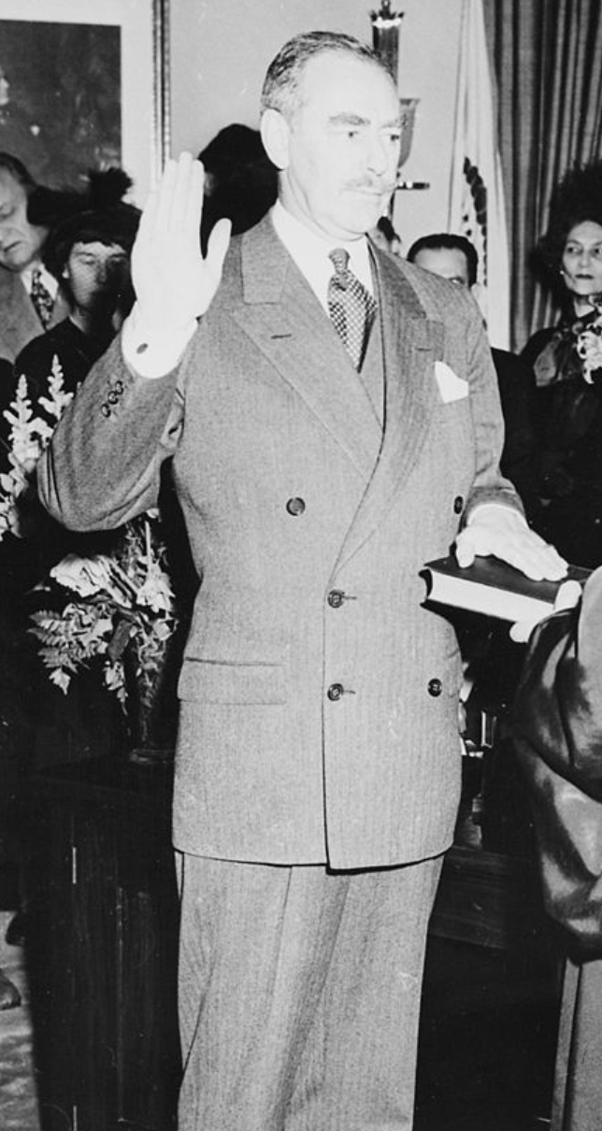
Plus Acheson
Dean Acheson, Secretary of State for Harry S Truman:
On the Republican Party as the party of wealth, enterprise, and opportunity:
“This business base of the Republican Party is stressed not in any spirit of criticism. The importance of business is an outstanding fact of American life. The achievements of business have been phenomenal. It is altogether appropriate that one of the major parties should represent its interests and its point of view…”
The subsequent transformation of the Republican Party from those who were going to become millionaires, or become even greater millionaires; to those who fear that they would lose it all…

Slide 73
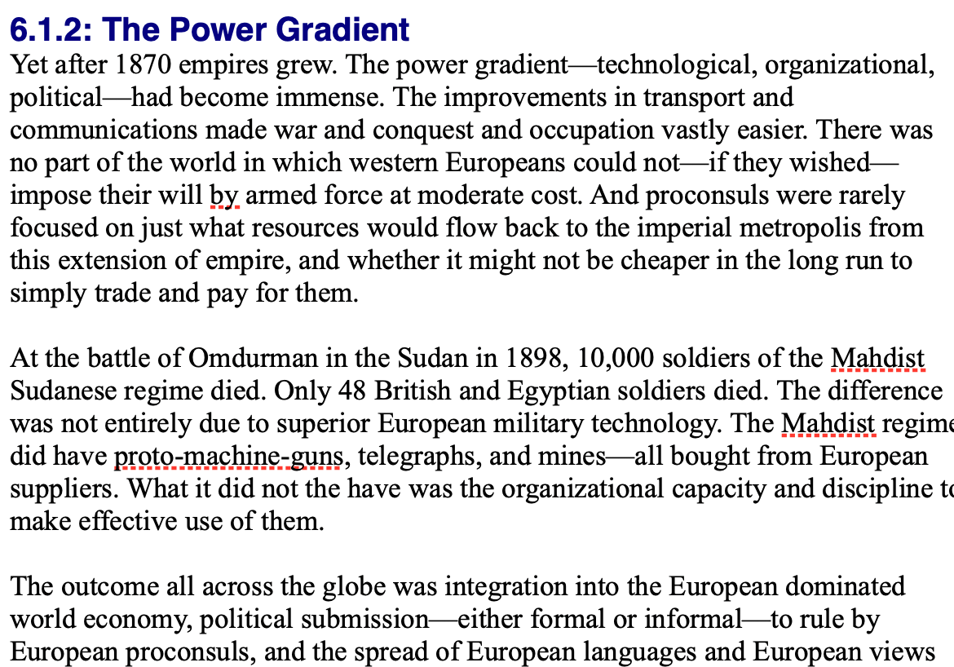
Review: Empire
By 1810 the tide of empire had been clearly ebbing…
But then things turned around: the power gradient:

Slide 74
To Your iClickers!
According to Eichengreen, graphing international capital flows and mobility since 1850 over time produces a graph that is:
V-shaped
U-shaped
W-shaped
An upward line
None of the above

Slide 75
To Your iClickers!
According to Eichengreen, the responsibilities of a pre-World War I central bank as steward of the global gold standard and also as lender-of-last-resort in domestic financial crises were:
in complete harmony
in irresolvable tension
for the most part manageable, before World War I at least, via fancy footwork and good luck
not understood
none of the above

Slide 76
To Your iClickers!
According to Eichengreen, the experience of being on the gold standard for North Atlantic economies in the 1870-1914 period was by and large a happy one, and the experience of countries at the world economy’s periphery was:
also by and large a happy one.
a mixed one.
a source of considerable tension, instability, and political upset.
once again, manageable with fancy footwork and a little good luck.
none of the above.

Slide 77
To Your iClickers!
In Eichengreen’s view, if World War I had somehow been avoided, would the global gold standard have remained stable in the 1920s and 1930s?
There are no guarantees, but probably yes.
There are no guarantees, but probably no.
Certainly not!
Certainly yes—unless several North Atlantic economies experienced a socialist revolution
None of the above.

Slide 78
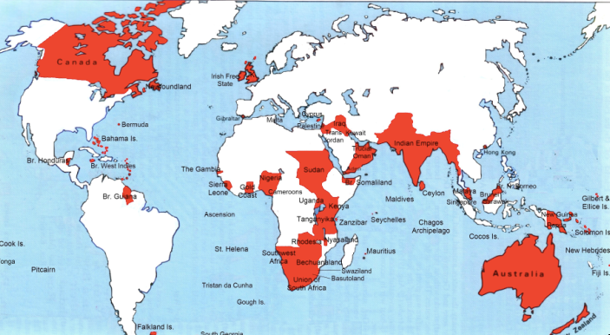
Empire

Slide 79
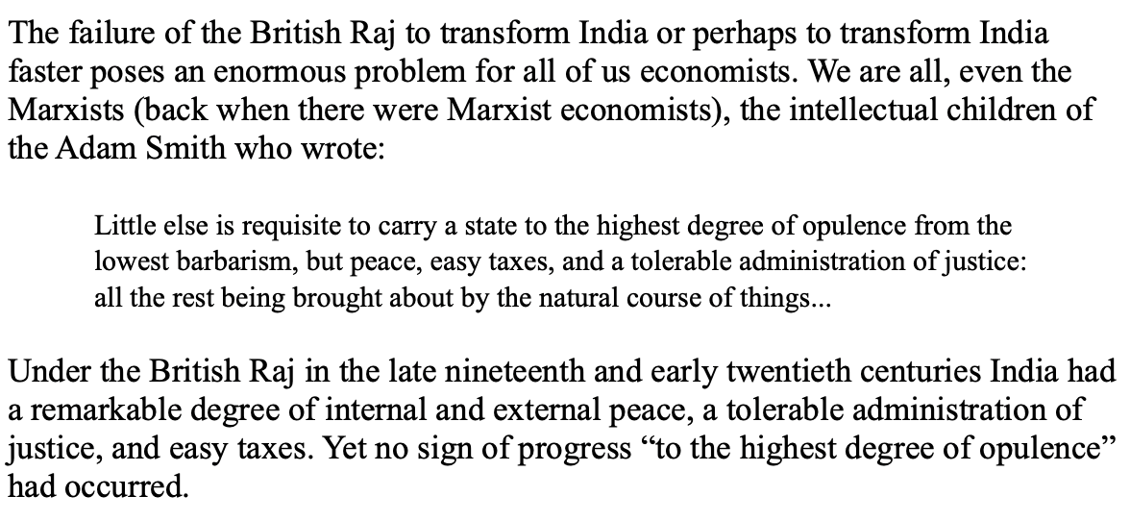
India
Why didn’t the British transform India into an industrial power?

Slide 80
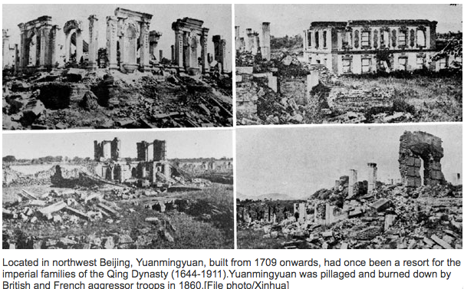
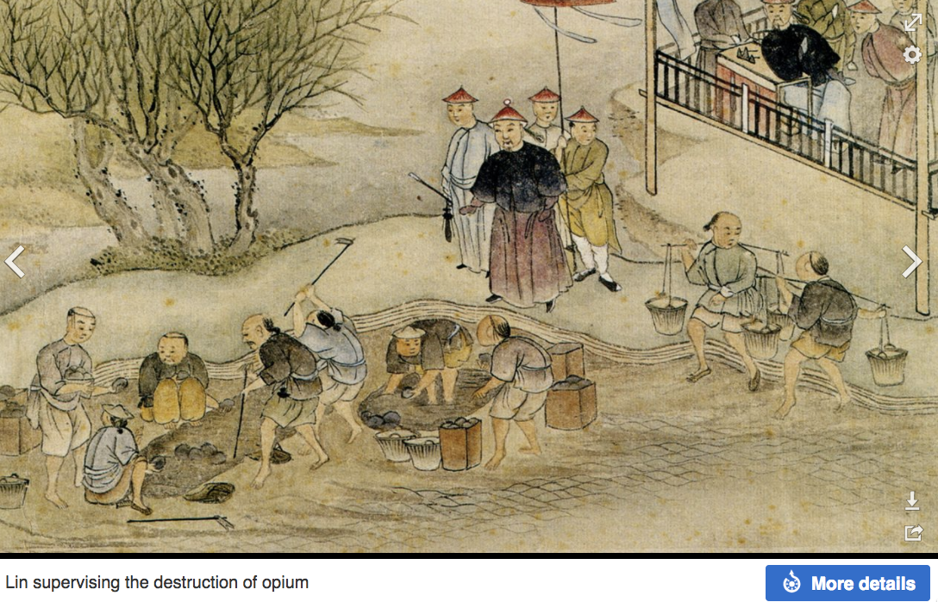
“Self-Strengthening”
The puzzle of China vs. Japan
Great Qing (大清)(1644-1912)
Wu Sangui (吳三桂)
The Rebellion of the Three Feudatories (三藩之亂)
Kangxi and Qianlong: “revere the emperor and expel the barbarians” is difficult to pursue when the emperor and his clan identify themselves as “barbarians”
Tai-Ping Rebellion (太平天國運動)
Cixi ( 慈禧太后)
Li Hongzhang (李鴻章)the Kai-Ping coal mine, Chang Yen-Mao, and Herbert Hoover

Slide 81
Formal Empires
There were, broadly, three views as to why European late-1800s empires rose to such domination, each of which with its own view of what was to be done to fix the situation:
One view is that of John Hobson: The major economic problem was the business cycle. Equipping the military needed to maintain the empire puts people to work. And an empire is a good source of consumers for the products of domestic factories. European governments that pursued empire, Hobson thought, were less likely to face economic distress and so more likely to continue in office.
A second view was that of Joseph Schumpeter: imperialism as the last gasp of military status aristocracy.
The third view was that empires were ordained by God—or at least morally required or desirable, for European powers had a civilizing mission. The Europeans were lucky enough to be the grownups, and it was the obligation of the grownups to civilize the world. But perhaps civilization is best spread by newspapers and books and merchants and engineers, rather than by alien proconsuls? Just a thought.

Slide 82
Informal Empires
But even where Britain (or France, or Germany, or Portugal, or Spain, or those who thought of themselves as descended from the conquistadores of Castile, or Anglo-Saxon settlers) did not rule, they reigned:
Britain seemed successful: playing by Britain’s rules seemed wise…
Britain was powerful: playing by Britain’s rules seemed likely to keep it from getting annoyed…
Britain was working very hard to make itself attractive—to make becoming a Briton-by-proxy of some sort straightforward and profitable in both money and cultural terms…
Britain was the first-mover hegemon: international cooperation was on its terms…

Slide 83
Catch Our Breath…
Comments?
Questions?

Slide 84
Review: Revolutions
“Petty Officer Lemmgen… arrived at the Ministry [of War]… found… Lieutenant HambuRger.... Lemmgen produced a typed document with the following text: ‘Comrades and Workers! The Ebert-Scheidemann government have made themselves impossible.... The undersigned Revolutionary Council has provisionally assumed power.’
“Lieutenant Hamburger inspected the document and became properly indignant. ‘But where are the signatures? Before I can comply with this order, you’ll have to go back and get it properly signed. Otherwise any little shorthand typist could declare the government deposed.’ Petty Officer Lemmgen... saw the logic…. So he and his men saluted... and made their way back to the Revolutionary Council to obtain the necessary signatures....
“But by the time he had obtained the signatures, Lemmgen had learned that the People’s Naval Division had declared itself neutral. So he did not return to the Ministry of War…”

Slide 85
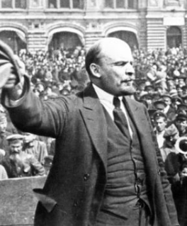
Lenin
A quick power grab…
Confidently expecting a German revolution, and then massive aid…
Brutal civil war
Kerenskyites
Reds
Whites
Nationalists
What was the revolutionary government to do?
Ludendorff’s German war economy…

Slide 86
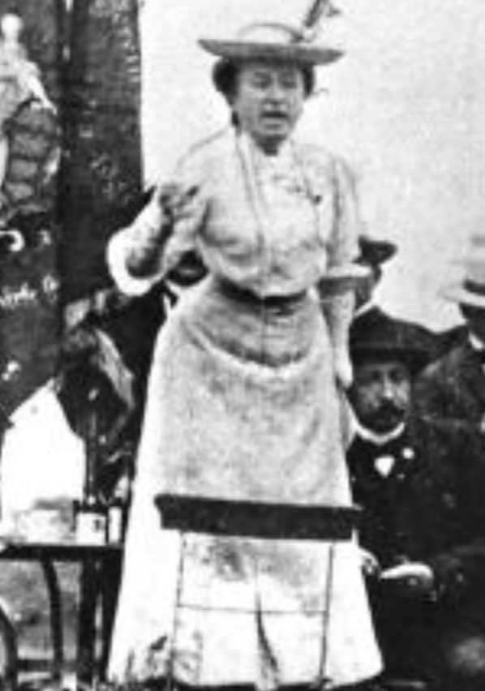
Red Rosa on Lenin
“Without general elections, without unrestricted freedom of press and assembly, without a free struggle of opinion, life dies out in every public institution…. Only the bureaucracy remains…. A few dozen party leaders of inexhaustible energy and boundless experience direct and rule….
“An elite of the working class is invited from time to time to meetings where they are to applaud the speeches of the leaders, and to approve proposed resolutions unanimously–at bottom, then, a clique affair…. Such conditions must inevitably cause a brutalization of public life: attempted assassinations, shooting of hostages, etc…
“Freedom only for the supporters of the government, only for the members of one party–however numerous they may be–is no freedom at all. Freedom is always and exclusively freedom for the one who thinks differently. Not because of any fanatical concept of “justice” but because all that is instructive, wholesome and purifying in political freedom depends on this essential characteristic, and its effectiveness vanishes when ‘freedom’ becomes a special privilege…

Slide 87

Review: The U.S.: The Roaring Twenties
The boom of the 1920s
Mass production—the flowering of the Second Industrial Revolution
“The business of America is business”
Structural changes in the 1920s…

Slide 88
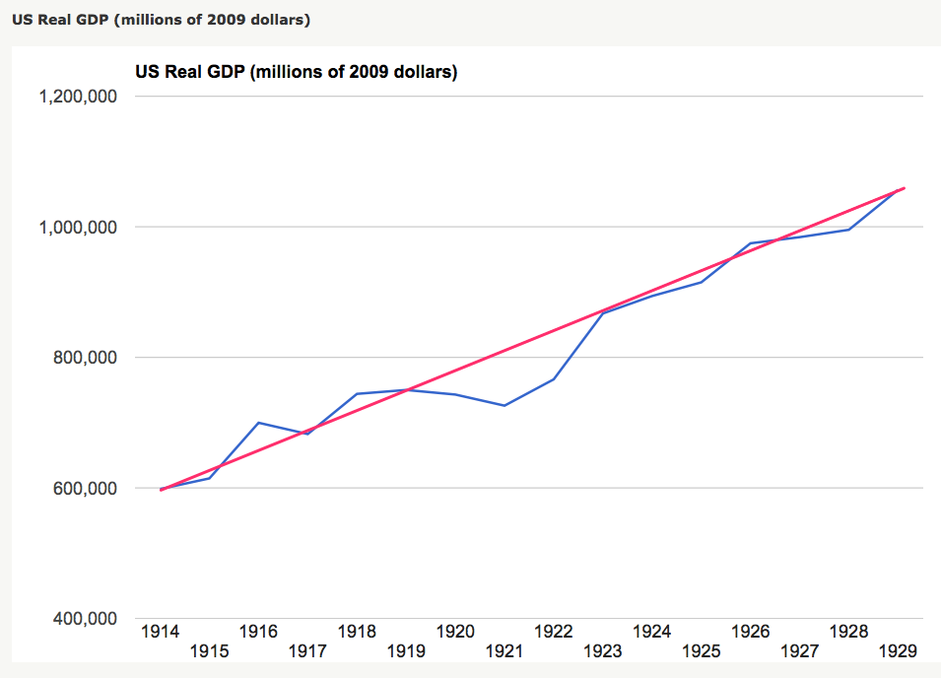
Structural Changes in the 1920s
Mass production—Henry Ford and the Model T
End of mass immigration—immigration restrictions of 1924
What do these do to the demand for construction, and construction workers?
The role of the stock market…
The role of the banking system…

Slide 89
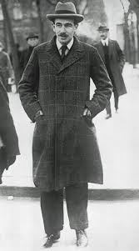
Review: To Your iClickers
John Maynard Keynes thought that the prosperity of the pre-WWI years was:
Natural and stable: a logical development out of human drives that went from strength to strength, and could only be overthrown by a very unlikely disaster.
Artificial and unstable, and based on a very complicated system in which, largely by chance, a lot happened to go right.
Natural but unstable, in that it was a logical development out of humanity’s trading nature but could be disturbed by other human drives—like tribalism, and the lust for domination.
Artificial but stable, as constructed by the greatest minds of the age, and only overthrown by a very unlikely disaster.
None of the above

Slide 90
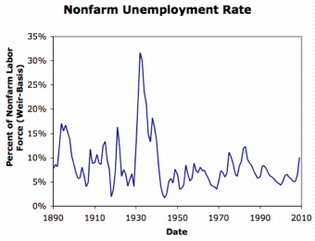
Review: Why the “Perfect Storm” of 1929-1933?
Previous Cycles:
1873—railroad
1884—railroad redux
1893—free silver
1904—Northern Securities
1907—gold drain to Britain
1914—disruption of the start of WWI
1920—deflation; return to “normalcy”
What brought previous downturns to a halt?
What made the Great Depression so great?

Slide 91
General Glut
How is it that there can be a "general glut" in which pretty much every produced commodity and the labor of workers are in excess supply, given that humans are far from satiated with production goods and given that one person's expenditure is another person's income?
Remember: you can take your income and use it either to buy things that are useful or to build up your stock of cash money. If there is excess demand for useful commodities, people can switch from producing whatever they were making to producing whatever is in short supply.
But the only way to build up your stock of cash is to try to cut your spending below your income. And since one person's spending is another person's income, that simply cannot be done in general.
If people in general try, the result is that spending and incomes fall economywide until they are both at such a low level that people de-prioritize building up their cash holdings.

Slide 92
What Had Ended Previous Downturns?
Previous Cycles:
1873—RR investment drops to zero
1884—RR investment drops to zero
1893—confidence that gold standard will be kept
1904—Theodore Roosevelt
1907—J.P. Morgan constitutes himself a pick-up central bank
1914—profits from European war demand WWI
1920—Federal Reserve reverses course

Slide 93
Interwar Gold Standard
The interwar gold standard caused, deepened, and definitely did nothing toward curing or ameliorating the Great Depression?
There is nothing worse than attempting to credibly commit to an incredible policy
The fear that the gold standard would break down caused people to want to hoard cash—to build up their cash holdings.
The fear that the gold standard would break down caused governments to be extremely unwilling to boost their economies' cash supplies—such boosts might, governments feared, undermine confidence that their country would stay on the gold standard.
Big depressions happen when the popular demand for cash outstrips the government's supply
The interwar gold standard was thus a powerful motivator and stage-setter pushing both people and governments into the patterns of behavior that produced the Great Depression

Slide 94
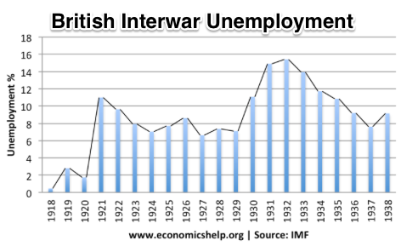
“Crying ‘Fire! Fire!’ in Noah’s Flood…”
France gold acquisition policy
American gold acquisition policy
The weakness of the gold-exchange standard—that people knew the gold standard could and would be abandoned
Labor-side pressure…
Nothing worse than an attempt to credibly commit to an incredible policy…
And then the belief that inflation was always just around the corner…

Slide 95
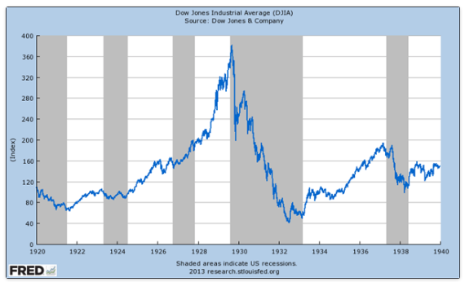
The Role of the Stock Market
Stock market doubles between the start of 1927 and late 1929
Positive-feedback margin trading
And a large number of people coming into the market who do not understand what is going on
Castles in the air
Prohibition?
Monetary policy?
Mass production?
The expectations shock produced

Slide 96
Why Was the Great Depression so Great?
John Maynard Keynes:
“When once the recovery has been started, the manner in which it feeds on itself and cumulates is obvious. But during the downward phase, when both fixed capital and stocks of materials are for the time being redundant and working-capital is being reduced, the schedule of the marginal efficiency of capital may fall so low that it can scarcely be corrected, so as to secure a satisfactory rate of new investment, by any practicable reduction in the rate of interest.
“Thus with markets organised and influenced as they are at present, the market estimation of the marginal efficiency of capital may suffer such enormously wide fluctuations that it cannot be sufficiently offset by corresponding fluctuations in the rate of interest. Moreover, the corresponding movements in the stock-market may, as we have seen above, depress the propensity to consume just when it is most needed. In conditions of laissez-faire the avoidance of wide fluctuations in employment may, therefore, prove impossible without a far-reaching change in the psychology of investment markets such as there is no reason to expect.
“I conclude that the duty of ordering the current volume of investment cannot safely be left in private hands….”

Slide 97
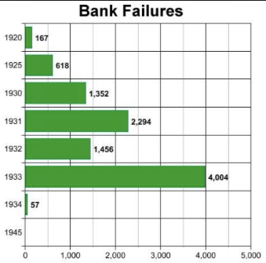
The Role of the Banking System
In the United States in the 1920s, about 600 banks failed a year—largely small rural banks
But banks set out to make riskier and riskier loans
Do they count on rescue from the Federal Reserve?
And when the Great Depression hits, bank failures rise to previously-unimaginable heights
Is there anything that could do more to boost the demand for or reduce the supply of cash?
And so call forth a general glut?
Lenders of “last resort”?

Slide 98
The Presumption Before the Great Depression
The presumption before the Great Depression that the government was not responsible for managing and curing the business cycle…
Two strands reinforced each other.
The first was the strength of the idea of laissez-faire: that government (protecting property and enforcing contracts aside) was overwhelmingly a problem and not a solution. As John Maynard Keynes wrote in his essay The End of Laissez-Faire, a powerful drive behind that was: “the corruption and incompetence of eighteenth-century government…. Almost everything which the State did in the eighteenth century in excess of its minimum functions was, or seemed, injurious or unsuccessful. [And] on the other hand, material progress between 1750 and 1850 came from individual initiative…”
The second was social Darwinism—that, in the words of steelmaster Andrew Carnegie, the second-richest man in America circa 1905 and a man who gave away his entire fortune: “The price we pay for [our civilization]... is, no doubt, great.... The employer of thousands is forced into the strictest economies... [in] the rates paid to labor.... The law of competition... is here; we cannot evade it; no substitutes for it have been found; and while the law may be sometimes hard for the individual, it is best for the race, because it insures the survival of the fittest in every department..."
The result was a dominant belief—at least among the rich and powerful—that:
The market giveth, the market taketh away: blessed be the name of the market.

Slide 99
The Hoover Administration’s Reaction to the Great Depression
The 1929-1933 Hoover administration believed that little could be done.
That the only good things that could be done were to (a) repeatedly state that "prosperity is just around the corner" and (b) try to cut federal government spending and raise taxes in order to restore confidence and scotch the fear of high inflation.
As economist R.G. Hawtrey wrote, to worry about inflation in the midst of the Great Depression was like "crying 'FIRE! FIRE!' in Noah's Flood..."
Herbert Hoover himself wrote afterwards about how his administration had been dominated by the "'leave-it-alone liquidationists' headed by Secretary of the Treasury Mellon, [who] felt that government must keep its hands off and let the slump liquidate itself. Mr. Mellon had only one formula:
'Liquidate labor, liquidate stocks, liquidate the farmers, liquidate real estate'. He held that even panic was not altogether a bad thing. He said: 'It will purge the rottenness out of the system. High costs of living and high living will come down. People will work harder, live a more moral life. Values will be adjusted, and enterprising people will pick up the wrecks from less competent people'…"
Hoover went on to state that he did not share this view…
That raises lots of questions about how his administration worked…

Slide 100
To Your iClickers
The largest automobile manufacturer in the world in 1928 was:
Toyota
Daimler-Benz
Peugeot
Ford
General Motors

Slide 101
To Your iClickers…
Worldwide, the Great Depression was was:
In relative terms, equalled by the Cleveland Depression of 1893-6
In relative terms, smaller than the depression that followed the Crash of 1873
In relative terms, equalled by the Great Recession of 2008-2020
In relative terms, by far the largest depression ever
None of the above

Slide 102
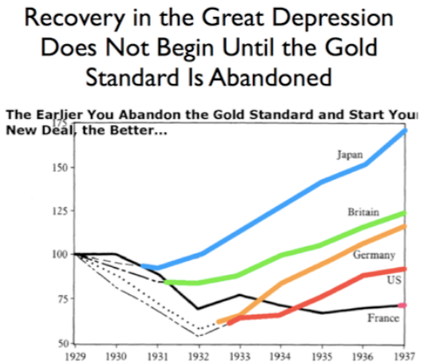
Review: New Deals
Japan: Takahashi Korekiyo
moved early to maintain full employment
Britain: MacDonald-Snowden-Baldwin
Forced off…
Germany: Adolf Hitler
Succeeds Bruening
America: Franklin Delano Roosevelt
Succeeds Herbert Hoover
France: Leon Blum

Slide 103
Recovery
Japan recovered the fastest,
Germany second,
Britain third,
The U.S. fourth,
France last.
By-and-large, the sooner you abandon the gold standard, expand the money supply, and undertake a "New Deal" to boost government spending, the better…

Slide 104
The Polanyian Perplex
People believe that the rights they have are broader and deeper than simply property rights, but the market economy disagrees.
Thus either governments will find a way to guarantee their populations these extra rights to community stability, general prosperity, and full employment, or society will react somehow against the liberal market-oriented political-economic system.
“Fictitious commodities”:
Land
Labor
Finance
Society’s “double movement”

Slide 105
The Permanent Problem of the Human Race
John Maynard Keynes thought that the economic problem would not be the "major problem of the human race"
By the end of the twentieth century the human race would be so rich that people would be practically satiated with commodities.
Thus the "economic problem" of how to economize and be efficient, and allocate scarce means among alternative uses, was not the permanent problem of the human race.
Instead, "for the first time since his creation man will be faced with his real, his permanent problem-how to use his freedom from pressing economic cares, how to occupy the leisure, which science and compound interest will have won for him, to live wisely and agreeably and well.... It will be those peoples, who can keep alive, and cultivate into a fuller perfection, the art of life itself and do not sell themselves for the means of life, who will be able to enjoy the abundance when it comes..."
Yet Keynes was not sure that having to confront this problem would be a net plus for humanity: "Will this be a benefit? If one believes at all in the real values of life, the prospect at least opens up the possibility of benefit. Yet I think with dread of the readjustment of the habits and instincts of the ordinary man, bred into him for countless generations, which he may be asked to discard within a few decades..."

Slide 106
Digression: How to Study
Will I ask you about Jan Christian Smuts? About the prayer (and theology) of the Grigua?
No…
Themes and concepts…
But you need narratives and stories to hang onto them…
And our brains are very good at deep-sixing useless information
Andy Matuschak: Why Books Don’t Work <https://andymatuschak.org/books/>:
“Picture some serious non-fiction tomes. The Selfish Gene; Thinking, Fast and Slow; Guns, Germs, and Steel; etc.
“Have you ever had a book like this—one you’d read—come up in conversation, only to discover that you’d absorbed what amounts to a few sentences? I’ll be honest: it happens to me regularly. Often things go well at first. I’ll feel I can sketch the basic claims, paint the surface; but when someone asks a basic probing question, the edifice instantly collapses. Sometimes it’s a memory issue: I simply can’t recall the relevant details. But just as often, as I grasp about, I’ll realize I had never really understood the idea in question, though I’d certainly thought I understood when I read the book. Indeed, I’ll realize that I had barely noticed how little I’d absorbed until that very moment. I know I’m not alone here…

Slide 107
Skipped Topic: Pre-1914 Political Economy: Over in Europe
The June Days of 1848 in Paris:
Tocqueville:
“The insurrection of June [1848]... class against class... a blind and rude, but powerful, effort on the part of the workmen to escape from the necessities of their condition, which had been depicted to them as one of unlawful oppression…. The closing of the national workshops… occasioned the rising…”
“Thousands… hastening to our aid from every part of France.... Thanks to the railroads, some had already come from fifty leagues’ distance... every class of society... peasants... shopkeepers... landlords and nobles all mingled together... they rushed into Paris with unequalled ardour: a spectacle as strange and unprecedented in our revolutionary annals.... The insurgents received no reinforcements, whereas we had all France for reserves…”

Slide 108
French Politics
Régimes stability is not on the menu:
the terrorist dictatorship of the Jacobins (the mainspring of popular government… amid revolution it is at once virtue and terror: virtue, without which terror is fatal; terror, without which virtue is impotent…)
a corrupt and gerrymandered 5-man executive of the Directory, defended on October 5, 1795 by the “whiff of grapeshot” of Napoleon Bonaparte and Joachim Murat, that managed to generate the first modern hyperinflation, defended itself against a royalist coup plotted by two of its five members (Barthelemy and Carnot) and its most successful general (Pichegru), and was then overthrown by the same Napoleon in 1799.
a dictatorship, with Napoleon Bonaparte as “First Consul”, until 1804.
an empire, with Napoleon Bonaparte as Emperor of the French, until suppressed by the other European powers in 1815.
a restored Bourbon monarchy, with first Louis XVIII and then Charles X, until 1830.
an alternative Orleanist monarchy, with King Louis-Philippes as the king-citizen, overthrown in 1848.
a second republic, overthrown by its own president, Napoleon’s nephew Louis Napoleon, which collapsed under pressure of military defeat in 1870.
a socialist commune, in Paris at least.
a third republic, which suppressed the commune—but promptly chose a royalist Marshal MacMahon, as president.
a failed attempt by third republic president Marshal MacMahon to replace himself by a King Henry V.
a failed attempt by the ex-Minister of War Georges Boulanger to seize power for his RRR movement: Revanche, Révision, Restauration (revenge on Germany, revision of the constitution, restoration of the monarchy).

Slide 109
Left-Wing Normal European Politics I
Disjunction between policies and rhetoric:
The Socialist Party of Germany’s Erfurt and Gotha programs seek things like: holidays for elections, two-year legislative terms, the right to bear arms, equal rights for women, the prohibition of spending public funds for religious purposes, free public schools and colleges, free medical care including midwifery, an eight-hour working day, no child labor under 14, a 36-hour minimum weekend, an occupational safety and health administration…

Slide 110
Left-Wing Normal European Politics II
Disjunction between policies and rhetoric:
But also: “By every lawful means to bring about a free state and a socialistic society, to effect the destruction of the iron law of wages by doing away with the system of wage labor.” And they sought: “the transformation of the capitalist private ownership of the means of production—land and soil, pits and mines, raw materials, tools, machines, means of transportation—into social property and the transformation of the production of goods into socialist production carried on by and for society.” And they believed: “This… emancipation… of the entire human race…. But it can only be the work of the working class, because all other classes… have as their common goal the preservation of the foundations of contemporary society.”

Slide 111
Center and Right-Wing Normal European Politics
The touchstone was “fairness”: it was not fair that those who did not work hard and did not play by the rules got lots of good things:
Those who did not play by the rules could be on either end of the wealth-and-power spectrum:
Parasitic aristocrats and cruel plutocrats
Those poor who wanted something for nothing, or got above their station
A middle-class, social order movement
Focus voters’ attention on the disruptive utopian aspirations of the left, and electoral coalitions could be preserved…
Preserve as much as possible of old orders of hierarchy in changing times:
Reform to preserve; change so things could stay the same
Find new reasons why hierarchy is good: social darwinism

Slide 112
Magnifying Non-Economic Cleavages Had Dangers
Society under threat not by economic inequality but by social disorder—or aliens—or other nations. Plus:
A right-wing landed and bureaucratic upper class that had, by and large, lost its social role.
A belief by politicians anxious to paper over class divisions that they could be papered over with national or ethnic unity.
A growing social-darwinist current that struggle was good, and the victors should be rewarded
Even or especially military struggle by peoples-in-arms, over not what language a province would be administered in but who would live there
These stored up trouble as 1914 approached.
In 1919 John Maynard Keynes was to write, bitterly, that he, his peers, and his elders had regarded:
“the projects and politics of militarism and imperialism, of racial and cultural rivalries, of monopolies, restrictions, and exclusion, which were to play the serpent to this paradise… [as] little more than the amusements of his daily newspaper…”

Slide 113
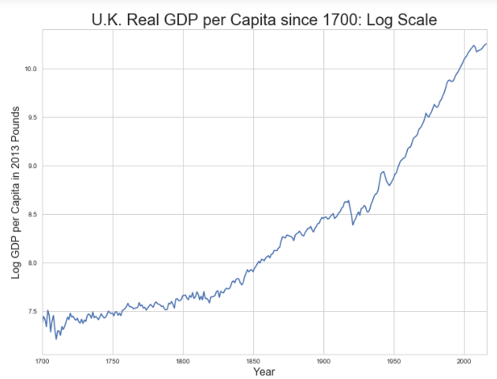
Skipped Topic: Passing the Baton: From Britain to America
The Industrial Revolution took place in Britain
The standard explanation four or five largely independent strands coming together.:
Limited government, security of property, and freedom of contract
Science and the technological tradition of sustained inquiry
Victory in the wars of the Commercial Revolution era
Machinery making, "tinkering", and "gadgets"—primarily made out of metal.
Coal in Britain—the only thing that made a steam engine potentially profitable.
Plus high elasticity of demand for leading-sector products…
http://bradford-delong.com brad.delong@gmail.com

Slide 114
iClickers: Why Breaktrhrough?
The principal reason that the Industrial Revolution took place in late eighteenth century Britain (rather than in Sung China, or Abbasid Baghdad, or Antonine Dynasty Rome, or during the Hellenistic Age) is:
A lack of human numbers thinking about problems of production
A lack of good means of communication—e.g. printing—for diffusing information about how to solve problems of production
A lack of experience using coal as an energy source
A lack of the incentive created by high real wages leading to a strong desire to make labor more productive
None of the above/not enough information
http://bradford-delong.com brad.delong@gmail.com

Slide 115
iClicker: Why Passing the Baton
The principal reason that the twentieth century was an American rather than a second British century was:
The United States’s aggressive and enthusiastic welcome of immigrants
The United States’s focus on broad-based technical education
The United States’s extraordinary abundance of natural resources driving high real wages and enormous incentives to build machines to manipulate matter
A U.S. government that took industrial development as a key policy goal, rather than being comfortable with laissez-faire
None of the above/not enough information
http://bradford-delong.com brad.delong@gmail.com

Slide 116
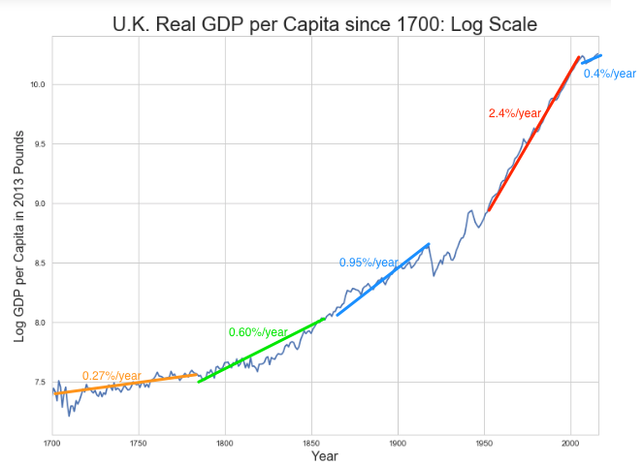
British Productivity Growth Acceleration
http://bradford-delong.com brad.delong@gmail.com

Slide 117
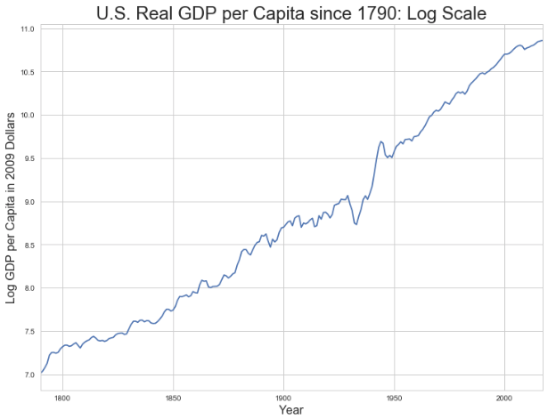
But Even in the First Half of the Nineteenth Century the U.S. Was Outpacing Britain in Growth…
Even in the first half of the nineteenth century—the period in which the British Industrial Revolution made it the wonder of the world—economic growth in the United States was proceeding faster than in Britain.
While British real GDP per capita was increasing at less than 0.6 percent per year
American was growing at a hair over one percent per year.
And a significantly larger share of GDP was going to the white working class in the United States, in the north at least:
The extraordinary abundance of land and the possibility of "lighting out for the territory", in the words of American author Mark Twain, gave even workers without property or notably scarce skills substantial economic bargaining power.
http://bradford-delong.com brad.delong@gmail.com

Slide 118
And Starting in the Late Nineteenth Century
Second Industrial Revolution…
Why the U.S. and Germany, and not Britain?
Immigration and Population
Was resource scarcity no longer a factor?
Was the differential in the growth rate h of the stock of useful economic knowledge even greater than the differential in the growth rate g of the efficiency-of-labor?
http://bradford-delong.com brad.delong@gmail.com

Slide 119
Phases of American Growth
1.0% per year in GDP per capita from 1760-1860: resource abundance
1.6% per year in GDP per capita from 1860-1929:
“Great traverse”: K/Y ratio up from 2.5 to 4
Half of it an increase in savings rates
Half of it a fall in the price of capital goods
2.5% per year in GDP per capita from 1929-1973
“Fordism”
Expected further acceleration: it did not happen
Post-1973
Productivity slowdown 1973-1995 (environment, oil, baby boom, feminism)
“New economy” 1995-2006
Post-2006 collapse of growth
http://bradford-delong.com brad.delong@gmail.com

Slide 120
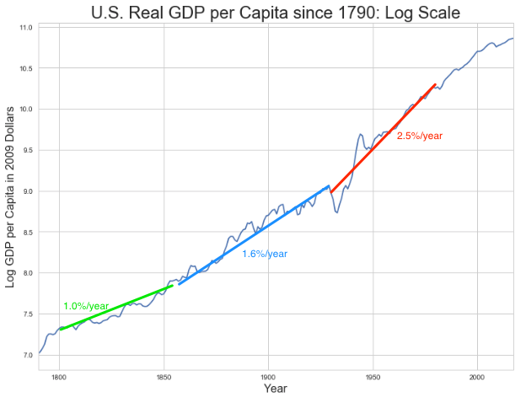
American Productivity Growth Acceleration
http://bradford-delong.com brad.delong@gmail.com

Slide 121
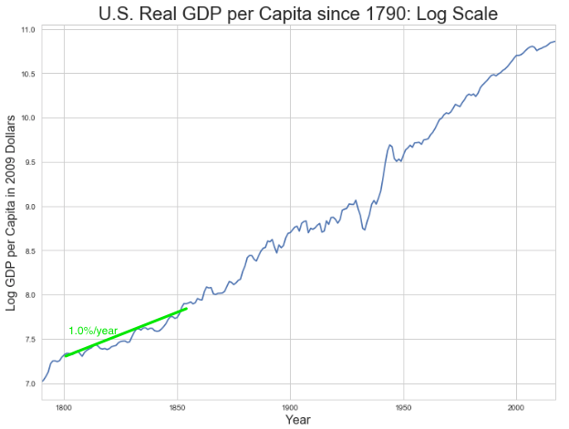
Early Nineteenth Century: Westward Expansion
Westward expansion
The “American System”
Abundant natural resources
Very high real wages
Focus on raising labor productivity
Hence fast efficiency-of-labor growth
Britain, by contrast, focused on economizing on (non-coal) raw materials
http://bradford-delong.com brad.delong@gmail.com

Slide 122
The Importance of Resources 1760-1860
Major westward expansion and "Amerindian removal”
The century 1760 to 1860 before the Civil War.
We have U.S. output-per-worker growth then at about 1.0% per year…
…in contrast to British output-per-worker growth at about 0.5% per year.
We have the U.S. population and labor force growing at 2.5% per year…
…from 2.5 to 30 million.
http://bradford-delong.com brad.delong@gmail.com

Slide 123
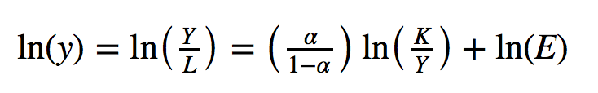
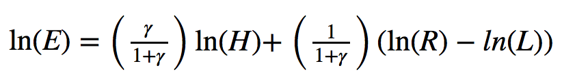
The Importance of Resources 1760-1860
Recall our basic Solow Model:
http://bradford-delong.com brad.delong@gmail.com

Slide 124
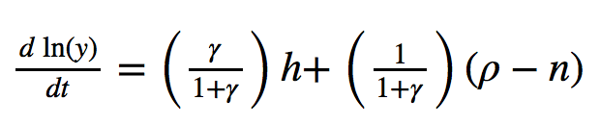
The Importance of Resources 1760-1860
Recall our basic Solow Model:
Assume K/Y constant, so the growth rate g of the efficiency of labor and the growth rate of output-per-worker are the same:
http://bradford-delong.com brad.delong@gmail.com

Slide 125
The Importance of Resources 1760-1860
Recall our basic Solow Model:
Assume K/Y constant, so the growth rate g of the efficiency of labor and the growth rate of output-per-worker are the same:
http://bradford-delong.com brad.delong@gmail.com

Slide 126
The Importance of Resources 1760-1860
Recall our basic Solow Model:
Assume K/Y constant, so the growth rate g of the efficiency of labor and the growth rate of output-per-worker are the same:
Let’s, last, fit this to history in the century before the 1860 election of President Abraham Lincoln and the ensuing American Civil War:
http://bradford-delong.com brad.delong@gmail.com

Slide 127

The Importance of Resources 1760-1860
Recall our basic Solow Model:
Assume K/Y constant, so the growth rate g of the efficiency of labor and the growth rate of output-per-worker are the same:
Let’s, last, fit this to history in the century before the 1860 election of President Abraham Lincoln and the ensuing American Civil War:
http://bradford-delong.com brad.delong@gmail.com

Slide 128

Westward Expansion
http://bradford-delong.com brad.delong@gmail.com

Slide 129

The Importance of Resources 1760-1860
We have two parameters left: γ and h, the weight of ideas in efficiency-of-labor growth and the rate of growth of the stock of useful ideas for the economy in American heads, respectively:
http://bradford-delong.com brad.delong@gmail.com

Slide 130

The Importance of Resources 1760-1860
We have two parameters left: γ and h, the weight of ideas in efficiency-of-labor growth and the rate of growth of the stock of useful ideas for the economy in American heads, respectively:
http://bradford-delong.com brad.delong@gmail.com

Slide 131
The Importance of Resources 1760-1860
Thus if γ→∞ then h→0.010
http://bradford-delong.com brad.delong@gmail.com

Slide 132
The Importance of Resources 1760-1860
Thus if γ→∞ then h=0.010
Thus if γ=3.0 then h=0.00667
http://bradford-delong.com brad.delong@gmail.com

Slide 133
The Importance of Resources 1760-1860
Thus if γ→∞ then h=0.010
Thus if γ=3.0 then h=0.00667
Thus if γ=1.0 then h=0.00
http://bradford-delong.com brad.delong@gmail.com

Slide 134
The Importance of Resources 1760-1860
Thus if γ→∞ then h=0.010
Thus if γ=3.0 then h=0.00667
Thus if γ=1.0 then h=0.00
Looking across the Atlantic Ocean to Great Britain, we see that over there it is indeed the case that h=0.005 from 1760 to 1860. Faster growth of h in America due to some catchup with the world's first and leading industrial nation seems likely. So γ=3.0 has some claim to be the most likely value…
http://bradford-delong.com brad.delong@gmail.com

Slide 135
A Counterfactual
The Royal Proclamation of October 1763:
Our Royal Will and Pleasure… no... Governor or Commander in Chief in... our... Colonies or Plantations in America do... grant Warrants of Survey, or pass Patents for any Lands beyond the Heads or Sources of any of the Rivers which fall into the Atlantic Ocean from the West and North West, or upon any Lands whatever, which, not having been ceded to or purchased by Us as aforesaid, are reserved to the said Indians, or any of them...
http://bradford-delong.com brad.delong@gmail.com

Slide 136

What If This Royal Proclamation Had Stuck?
What if ρ=0?
If γ → ∞ and h=0.010 then g=0.01
If γ=3.0 and h=0.00667 then g=−0.00125
If γ=1.5 and h=0.000 then g=−0.01
http://bradford-delong.com brad.delong@gmail.com

Slide 137
What If This Royal Proclamation Had Stuck?
What if ρ=0?
If γ → ∞ and h=0.010 then g=0.01
If γ=3.0 and h=0.00667 then g=−0.00125
If γ=1.5 and h=0.000 then g=−0.01
An America penned behind the Appalachians would probably have seen its living standards and productivity levels not growing at 1% per year from 1760 to 1860 but shrinking.
For γ=3.0, living standards and productivity levels would have shrunk at a pace of -0.125% per year
http://bradford-delong.com brad.delong@gmail.com

Slide 138
What If This Royal Proclamation Had Stuck?
What if ρ=0?
Of course, a poorer America would probably have seen fewer immigrants.
But it might not have seen that many fewer immigrants.
It would no longer have been quite as attractive to move from Britain to America over 1760 to 1860.
But it still would have been very attractive to move from France, Germany, Scotland—or most of all from Potato Blight-ridden Ireland...
In what other ways might this counterfactual alternate-history "little America" would likely have been different in 1860 than America actually was?
http://bradford-delong.com brad.delong@gmail.com

Slide 139

“Trail of Tears’
http://bradford-delong.com brad.delong@gmail.com

Slide 140
A large chunk of America's pre-1860 visible growing prosperity was based not just on African-American slavery, but also on "Amerindian removal"
http://bradford-delong.com brad.delong@gmail.com

Slide 141
Catch Our Breath…
Ask me two questions…
Make two comments…

Slide 142

Late Nineteenth-Early Twentieth Century: “Great Traverse”
Invention of the industrial research lab
First globalization
Technologies of Second Industrial Revolution
Economies of scale and mass production
Falling price of capital goods
Greater savings effort
Plus mass immigration
Rapidly rising inequality
Or was it? Emancipation…
http://bradford-delong.com brad.delong@gmail.com

Slide 143
Capital Deepening
Lowered deprecation rate δ
From 5% to 3% per year
http://bradford-delong.com brad.delong@gmail.com

Slide 144
Capital Deepening
Lowered deprecation rate δ
From 5% to 3% per year
Increased savings rate s
Capital-output ratio goes from 2.5 to 4 across 70 years
http://bradford-delong.com brad.delong@gmail.com

Slide 145
Capital Deepening
Lowered deprecation rate δ
From 5% to 3% per year
Increased savings rate s
Capital-output ratio goes from 2.5 to 4 across 70 years
with an α=1, output-per-worker proportional to the capital-output ratio
ln(4/2.5)/70 = 0.007
g = 0.9%/year
http://bradford-delong.com brad.delong@gmail.com

Slide 146
Capital Deepening
Capital-output ratio goes from 2.5 to 4 across 70 years
with an α=1, output-per-worker proportional to the capital-output ratio
ln(4/2.5)/70 = 0.007
g = 0.9%/year
Second Industrial Revolution
Large managerial corporation
Large-scale investment banking
Industrial research lab
Continent-wide market
Globalization
http://bradford-delong.com brad.delong@gmail.com

Slide 147

Mid Twentieth Century: Drive to High Mass Consumption
DARPA, etc.: two heads are better than one
“Fordist” oligopolies
Second globalization
Keynesian stabilization policies
Falling and then low inequality
For white guys…
http://bradford-delong.com brad.delong@gmail.com

Slide 148
Mid Twentieth Century: Drive to High Mass Consumption
DARPA, etc.: two heads are better than one
“Fordist” oligopolies
Second globalization
Keynesian stabilization policies
Falling and then low inequality
For white guys…
http://bradford-delong.com brad.delong@gmail.com

Slide 149
Catch Our Breath…
Ask me two questions…
Make two comments…

Slide 150
Notes

